Slide 1

Azure Container Service - Overview
Andy Zhang
Senior Software Engineer
Azure Kubernetes Team
Github: andyzhangx
xiazhang@microsoft.com

Slide 2


Table of contents
Azure Container Registry
Azure Kubernetes Service (AKS)
Release automation tools
Containers 101
Azure container technology
Open Service Broker for Azure (OSBA)
Container orchestration
Azure Container Instances (ACI)

Slide 3
Containers 101
Azure Container Registry
Azure Kubernetes Service (AKS)
Release automation tools
Containers 101
Azure container technology
Open Service Broker for Azure (OSBA)
Container orchestration
Azure Container Instances (ACI)

Slide 4
From traditional app to modern app
APP
Existing Application
Modern Infrastructure
rehost as VMs or refresh to modern container platform.
Containerize Applications
Re-architect apps for scale with containers.
Modern Microservices
Add new services or start peeling off services from monolithic code.
On-Premises
Infrastructure Platform
IaaS
Infrastructure Platform
“lift & shift”
Containers
Container Platform
PaaS
Application Platform
Serverless

Slide 5
What is a container?
Containers = operating system virtualization
Traditional virtual machines = hardware virtualization
OS
Application
VM
VM
VM
Applications
Container
Container
Container
App
App
App
Kernel
OS
OS
OS
OS
Hardware
Hardware

Slide 6
Virtualization versus containerization
Virtual machine
Container
Application XYZ
Application
App dependencies
Dependencies
Guest OS
C
C
C
C
C
VM
VM
VM
VM
VM
VM
Dependency 1
Dependency 2
Hypervisor 2
Docker Engine
Hypervisor 1
Host OS
Host OS
Hardware
Hardware
Hardware
Type 1
Type 2
Virtualization
Containerization

Slide 7
The container advantage
Traditional virtualized environment
VM
VM
Low utilization of container resources
Application
Con.
Con.
Application
Containerization of applications and their dependencies
Con.
Con.
Hypervisor 2
Host OS
Hardware

Slide 8
The container advantage
Containerized environment
Migrate containers and their dependencies to underutilized VMs for improved density and isolation
VM
VM
Con.
Con.
Decommission unused resources for efficiency gains and cost savings
Con.
Con.
Docker Engine
Host OS
Hardware

Slide 9

The container advantage
Fast iteration
Agile delivery
Immutability
Cost savings
Efficient deployment
Elastic bursting
For developers
For IT
Notes:
为什么要使用Docker容器技术？
一、快速交付应用程序
二、更高效的虚拟化
三、更轻松的迁移和扩展
四、快速部署也意味着更简单的管理

Slide 10


Containers are gaining momentum
Does your organization currently use container technologies?¹
23%
My org. is evaluating container technologies
Yes, my org. currently uses container technologies
No, my org. is not using container technologies
Not sure
Not applicable
Larger companies are leading adoption.²
42%
~60%
25%
7%
Nearly 60% percent of organizations running 500 or more hosts are classiﬁed as container dabblers or adopters.
2%
The average company QUINTUPLES its container usage within 9 months.¹
Container hosts often run SEVEN containers at a time.¹
Containers churn 9 times FASTER than VMs.¹
5x
7x
9x
Source:
1: Datadog: 8 Surprising Facts About Real Docker Adoption; 2: DZone: The DZone Guide to Deploying and Orchestrating Containers

Slide 11


Industry analysts agree
“By 2020, more than 50% of enterprises will run mission-critical, containerized cloud-native applications in production, up from less than 5% today.”

Slide 12
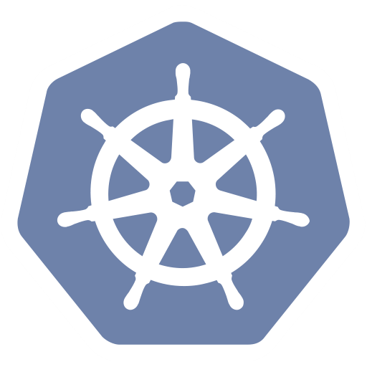
Container orchestration
Azure Container Registry
Azure Kubernetes Service (AKS)
Release automation tools
Containers 101
Azure container technology
Open Service Broker for Azure (OSBA)
Container orchestration
Azure Container Instances (ACI)

Slide 13
The elements of orchestration
Scheduling
Affinity/anti-affinity
Health monitoring
Failover
Scaling
Networking
Service discovery
Coordinated app upgrades
Notes:
Service discovery
Affinity:
可以限制Pods在特定节点上运行，也可以优先调度到特定节点。有几种方式可以实现这个功能，它们都使用选择标签的方式完成。通常情况下这些限制是没必要的，k8s会自动实现合理的调度（例如，pods在集群中调度时，不会被调度到资源不足的节点上）。但是，有些场景下，希望对运行pod的节点进行限制，如需要将pod调度到磁盘为SSD的节点上，或将两个不同的服务但需要经常通信的pod调度到同一个zone。
Service discovery is one of the core functionalities of any container-based environment. Once you have packaged your application and launched it using containers, the next step is making it discoverable to other application containers in your environment or the external world.

Slide 14
Container Management at Scale
Cluster Management: deploy and manage cluster resources
Scheduling: where containers run
Lifecycle & Health: keep containers running despite failure
Service Discovery & Load Balancing: where are my containers and how to connect
Security: control access to cluster resources and protect secrets
Scaling: make sets of containers elastic in number
Image repository: centralized, secure Docker container images
Continuous Delivery: CI/CD pipeline and workflow
Logging & Monitoring: track what’s happening in containers and cluster
Storage volumes: persistent data for containers
Notes:
“Container-centric infrastructure”
Additionally: configuration management, debugging/introspection, identity and authorization

Slide 15
Kubernetes: the de-facto orchestrator
Portable
Public, private, hybrid, multi-cloud
Extensible
Modular, pluggable, hookable, composable
Self-healing
Auto-placement, auto-restart, auto-replication, auto-scaling
Notes:
Docker Swarm, Mesos and Kubernetes

Slide 16
Kubernetes: empowering you to do more
Deploy your applications quickly and predictably
Scale your applications on the fly
Roll out new features seamlessly
Limit hardware usage to required resources only

Slide 17
Kubernetes Concepts

Slide 18
Kubernetes Architecture Components
api-server
etcd
master components
controller-manager
scheduler
* Azure Managed
kubelet
kube-proxy
node components
docker
dns
Notes:
api-server: k8s cluster management API, interacting with etcd
Controller-mananager: all service controllers including storage, network, deployment, service
Kube-proxy: TCP, UDP traffic forwarding

Slide 19


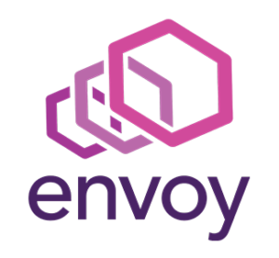

Pod
Notes:
pod: the smallest unit that k8s could schedule

Slide 20
pod
pod
wordpress-web
wordpress-mariadb
port
80
port
27017
Notes:
Rating web

Slide 21
Deployment
label
app=wordpress-web, tier=web
image
docker.io/bitnami/wordpress:5.1.0
pod
wordpress-web-1
port
80
port
pod
wordpress-web-2
port
80
wordpress-web

Slide 22
Deployment
label
app=wordpress-web, tier=web
image
docker.io/bitnami/wordpress:5.1.0
pod
Service
wordpress-web-1
port
80
wordpress-web
pod
port
selector
app=wordpress-web
wordpress-web-2
port
80:80
port
80
IP
42.159.236.71
wordpress -web

Slide 23
apiVersion: apps/
Kind: deployment
Metadata:
name: rating-web
apiVersion: apps/
Kind: deployment
Metadata:
name: rating-web
apiVersion: apps/
Kind: deployment
Metadata:
name: rating-web
customResorce
micro-web
api-server
port
8000
deployment
service
ingress
rating-web
rating-web
rating-web
port
8080
port
8080
port
8080
pod
pod
rating-web
rating-web
port
8080
port
8080
Notes:
Ingress: HTTP traffic forwarding

Slide 24
Azure container technology
Azure Container Registry
Azure Kubernetes Service (AKS)
Release automation tools
Containers 101
Azure container technology
Open Service Broker for Azure (OSBA)
Container orchestration
Azure Container Instances (ACI)

Slide 25
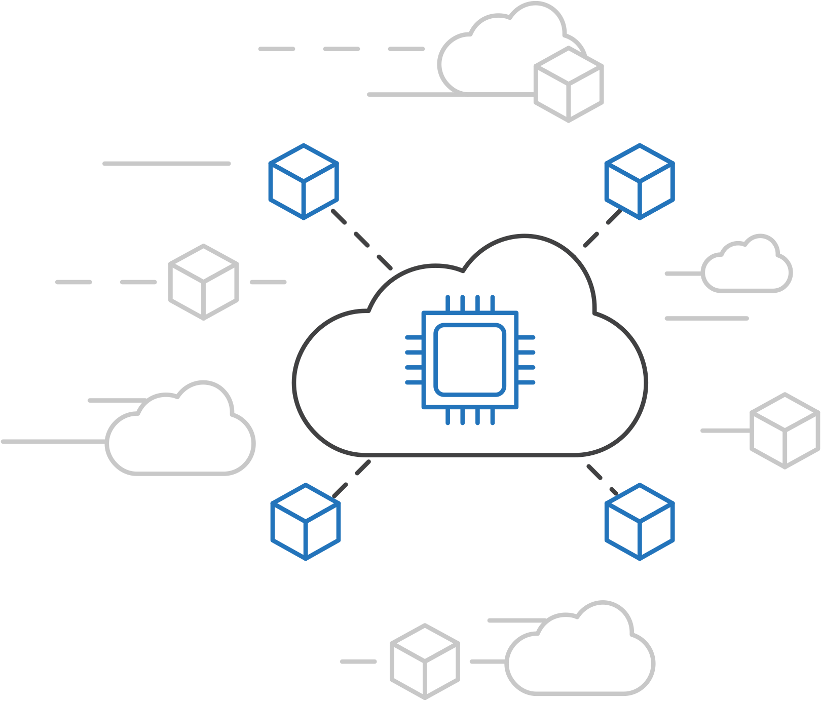
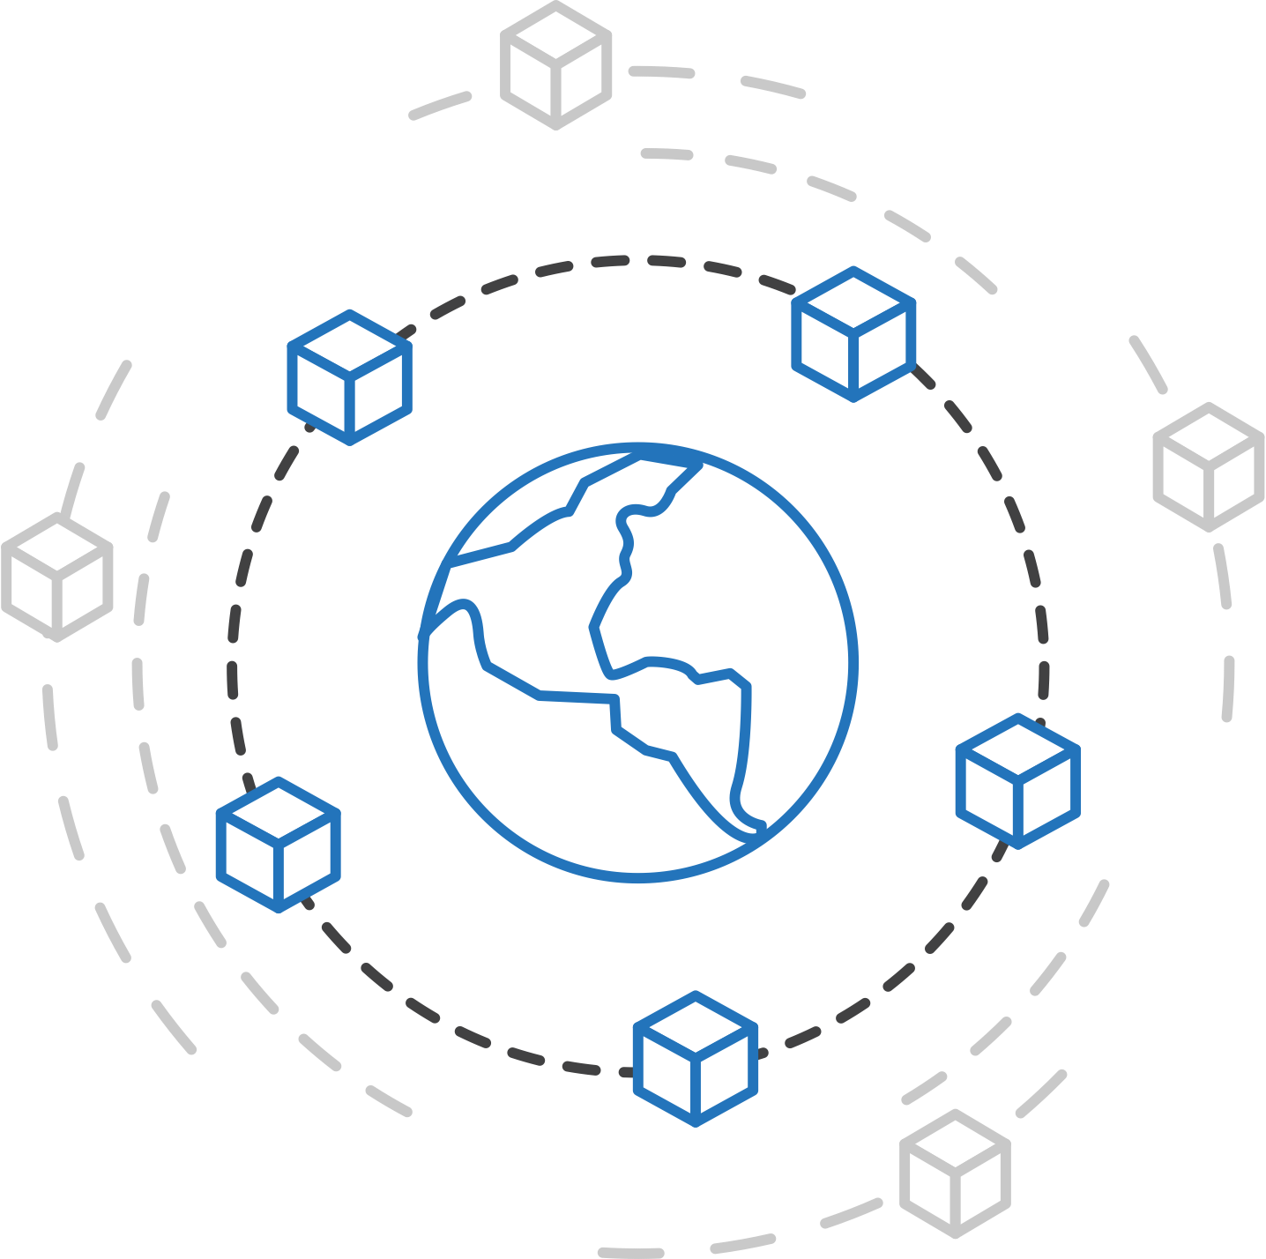
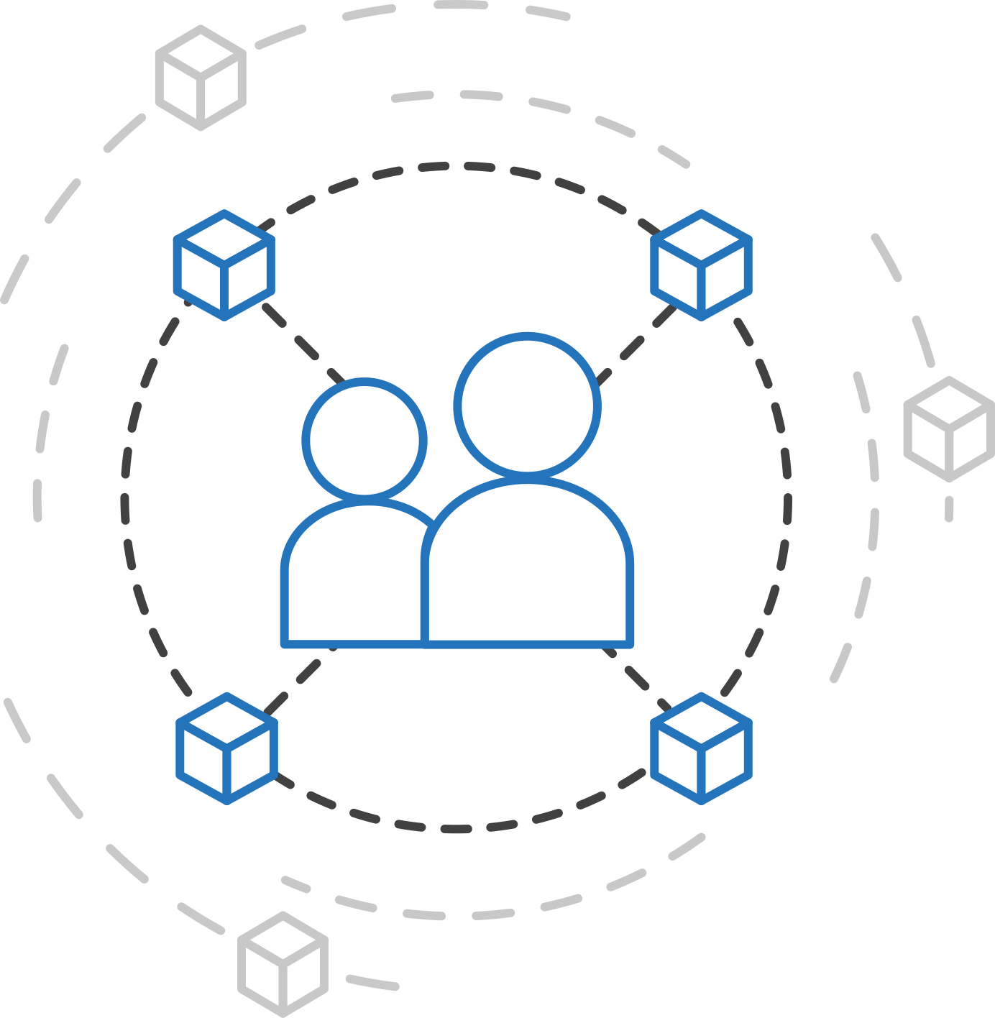
Azure container strategy
Embrace containers as ubiquitous
Support containers across the compute portfolio
Democratize container technology

Slide 26

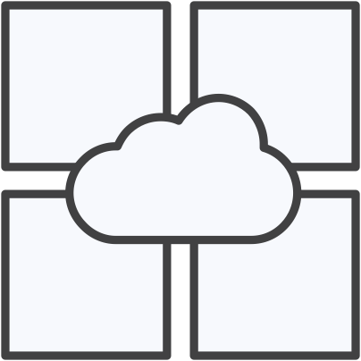

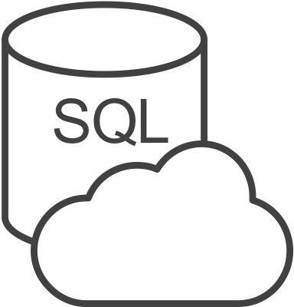



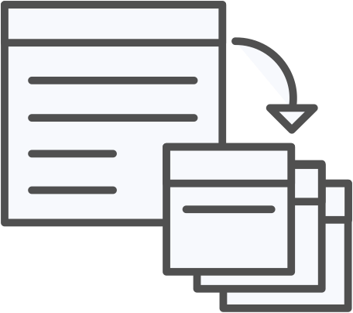



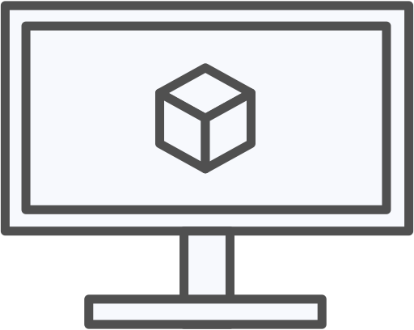
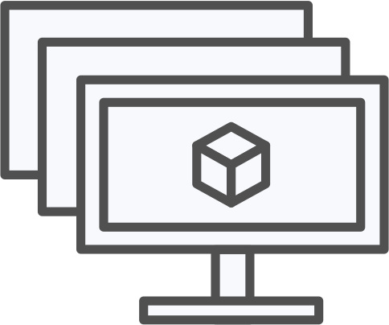
Azure container ecosystem
OSBA
App Service
Azure Container Registry (ACR)
Partner services
Azure services
PaaS
OpenShift
SQL Database
Azure Kubernetes Service (AKS)
Service Fabric
Batch
Pivotal Cloud Foundry
Redis Cache
AKS Engine
Docker Enterprise Edition
CosmosDB
Virtual kubelet
Mesosphere DC/OS
And more!
Azure Container Instances (ACI)
Azure Virtual Machines
Virtual Machine Scale Sets (VMSS)
Azure
IaaS

Slide 27
Azure Kubernetes Service (AKS)
Azure Container Registry
Azure Kubernetes Service (AKS)
Release automation tools
Containers 101
Azure container technology
Open Service Broker for Azure (OSBA)
Container orchestration
Azure Container Instances (ACI)

Slide 28

Azure Kubernetes Service (AKS)
Azure Kubernetes Service (AKS)
Azure Container Instances (ACI)
OSBA
App Service
Azure Container Registry (ACR)
Partner services
Azure services
PaaS
Azure Container Registry
OpenShift
SQL Database
Azure Kubernetes Service (AKS)
Service Fabric
Batch
Pivotal Cloud Foundry
Redis Cache
AKS Engine
Open Service Broker API (OSBA)
Docker Enterprise Edition
CosmosDB
Virtual kubelet
Mesosphere DC/OS
And more!
Azure Container Instances (ACI)
Azure Virtual Machines
Virtual Machine Scale Sets (VMSS)
Release Automation Tools
Azure
IaaS

Slide 29
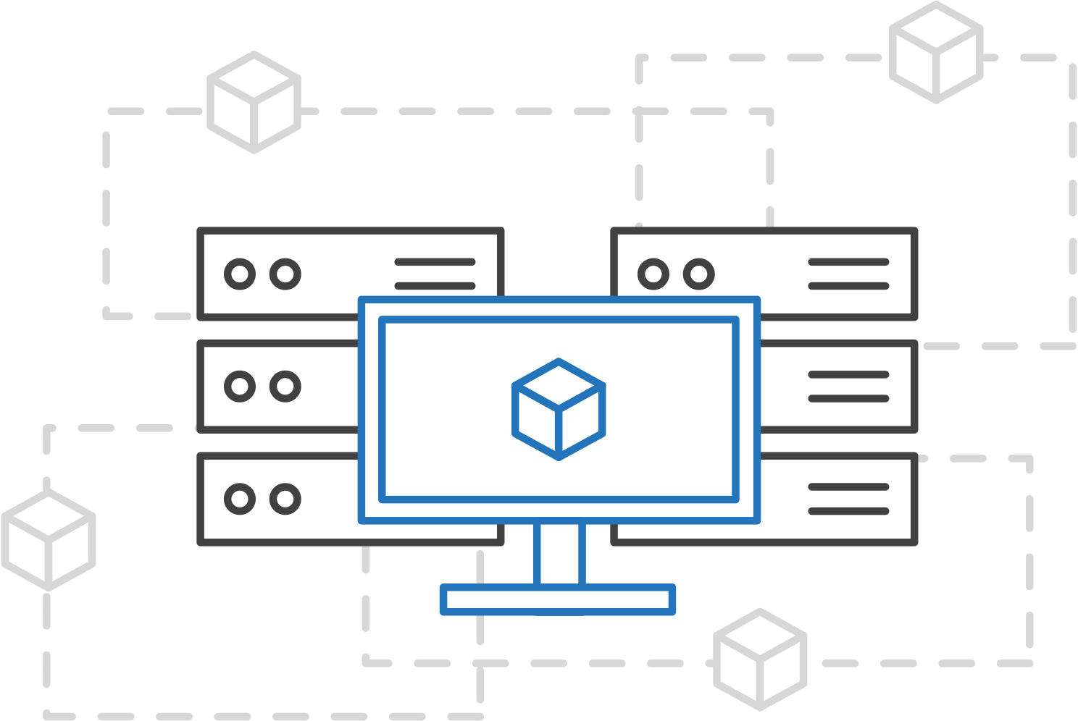
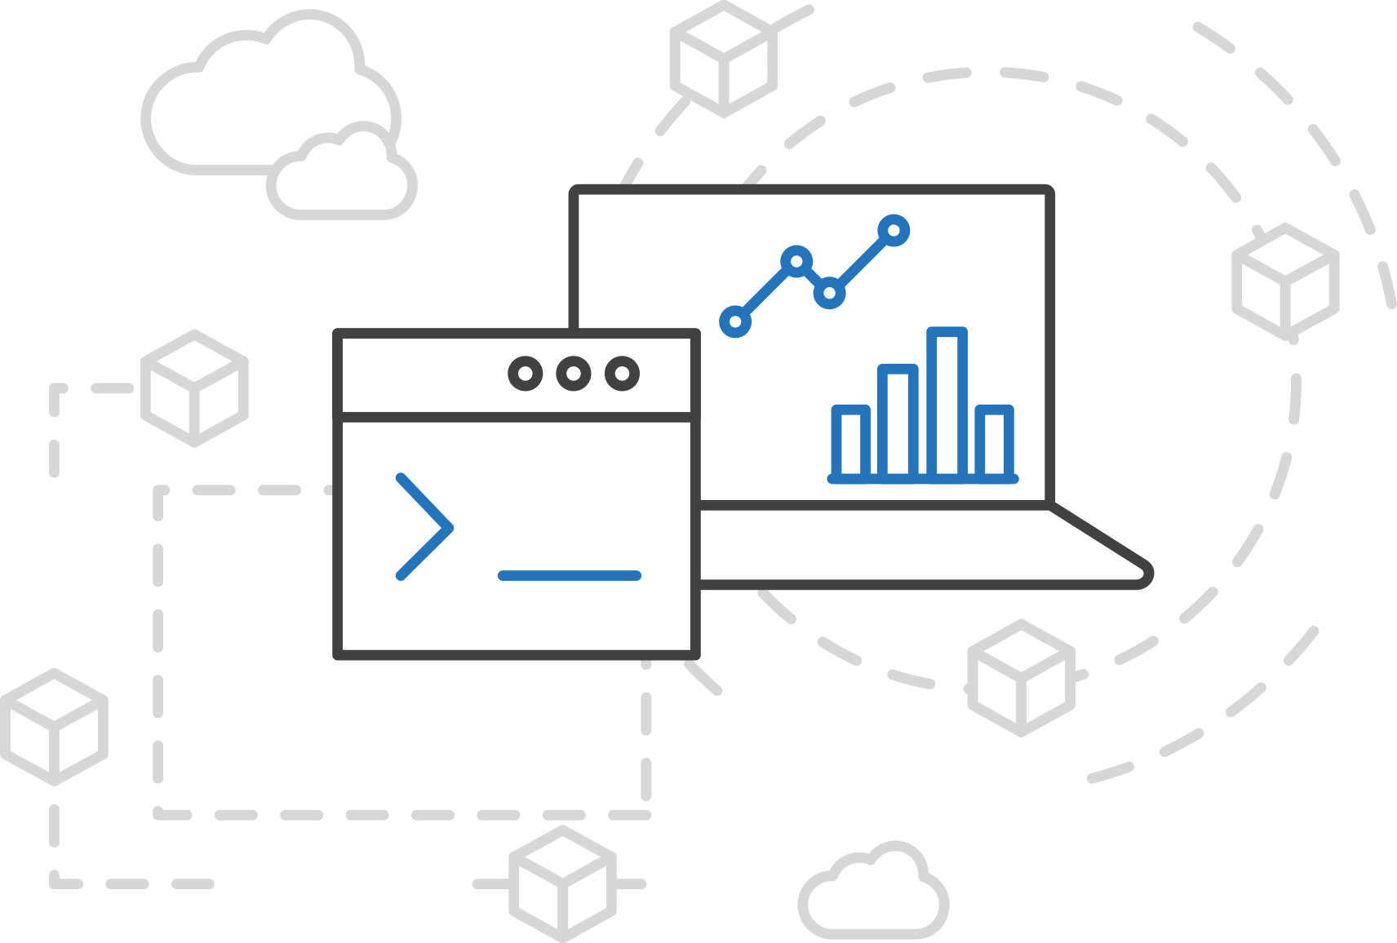
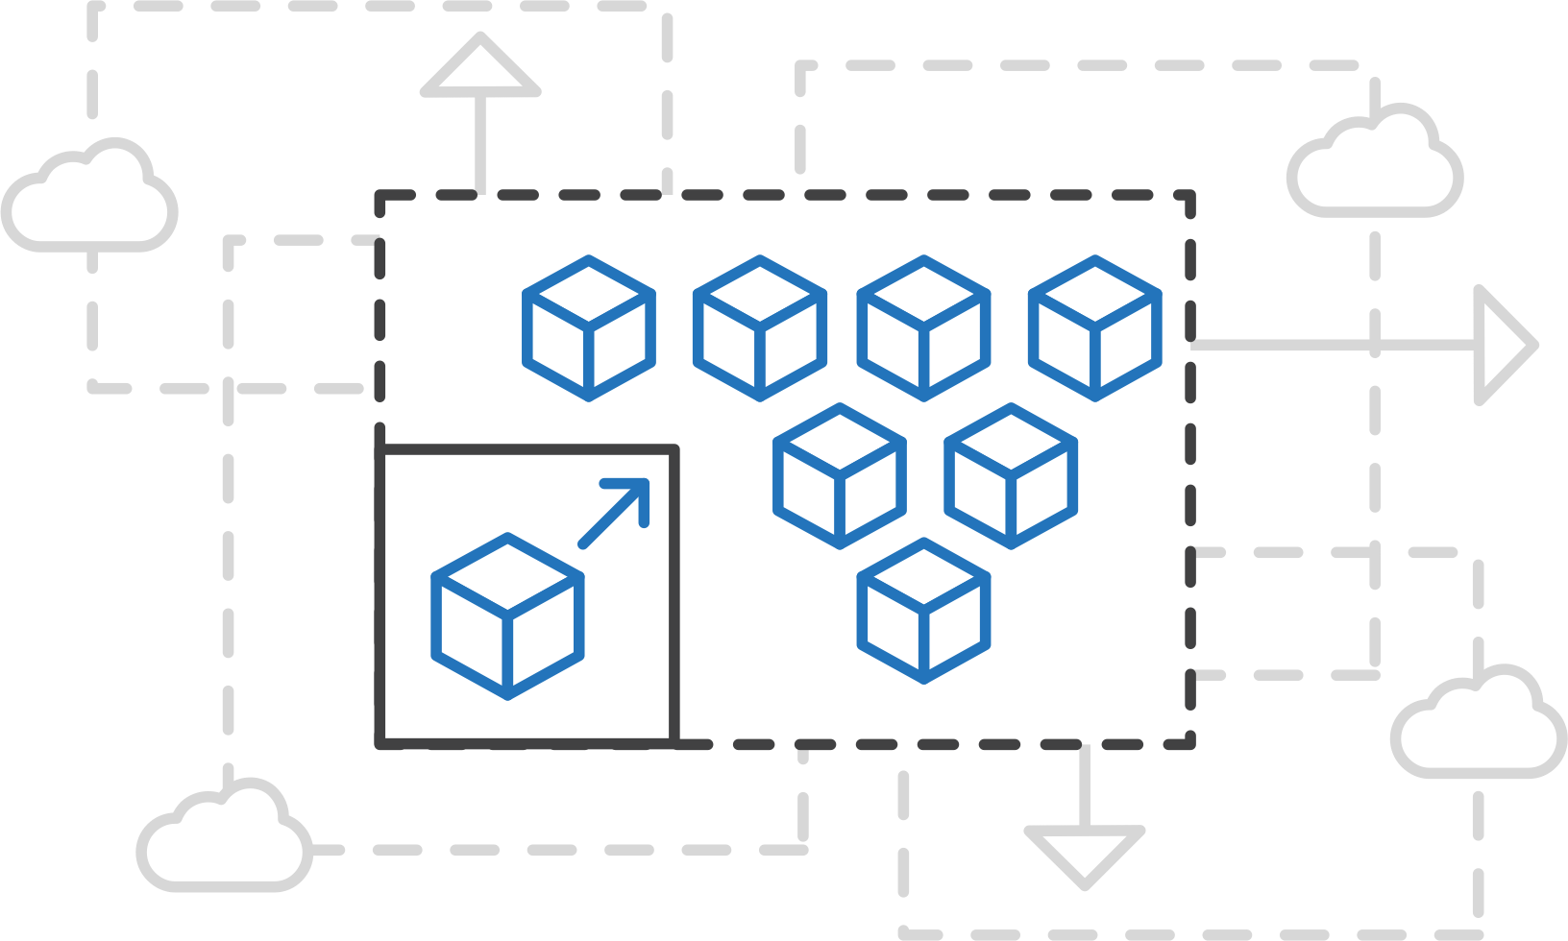
Azure Kubernetes Service (AKS)
Azure Kubernetes Service (AKS)
Simplify the deployment, management, and operations of Kubernetes
Azure Container Instances (ACI)
Azure Container Registry
Open Service Broker API (OSBA)
Focus on your containers not the infrastructure
Work how you want with open-source APIs
Scale and run applications with confidence
Release Automation Tools
Notes:
Work how you want with open-source APIs – kubectl, kubernetes dashboard

Slide 30
Azure Kubernetes Service (AKS)
Azure Kubernetes Service (AKS)
A managed Kubernetes cluster
Azure Container Instances (ACI)
Managed control plane
Automated upgrades, patches
Easy cluster scaling
Self-healing
Cost savings
Azure Container Registry
Managed
Application architect
Applications
Open Service Broker API (OSBA)
Operations
Kubernetes
Infrastructure architect
Docker
Release Automation Tools
Azure infrastructure services

Slide 31
Azure Kubernetes Service (AKS)
Azure Kubernetes Service (AKS)
Get started easily
Azure Container Instances (ACI)
$ az aks create -g myResourceGroup -n myCluster --generate-ssh-keys
\ Running ..
$ az aks install-cli
Downloading client to /usr/local/bin/kubectl ..
$ az aks get-credentials -g myResourceGroup -n myCluster
Merged "myCluster" as current context ..
$ kubectl get nodes
NAME STATUS AGE VERSION
aks-mycluster-36851231-0 Ready 4m v1.12.4
aks-mycluster-36851231-1 Ready 4m v1.12.4
aks-mycluster-36851231-2 Ready 4m v1.12.4
Azure Container Registry
Open Service Broker API (OSBA)
Release Automation Tools
Notes:
kubectl – open source tool

Slide 32
Azure Kubernetes Service (AKS)
Azure Kubernetes Service (AKS)
Manage an AKS cluster
Azure Container Instances (ACI)
$ az aks list –o table
Name Location ResourceGroup KubernetesRelease ProvisioningState
------------------ ---------- -------------- ------------------- -------------------
myCluster westus2 myResourceGroup 1.12.4 Succeeded
$ az aks upgrade -g myResourceGroup -n myCluster –-kubernetes-version 1.12.5
\ Running ..
$ kubectl get nodes
NAME STATUS AGE VERSION
aks-mycluster-36851231-0 Ready 12m v1.12.5
aks-mycluster-36851231-1 Ready 8m v1.12.5
aks-mycluster-36851231-2 Ready 3m v1.12.5
$ az aks scale -g myResourceGroup -n myCluster --agent-count 10
\ Running ..
Azure Container Registry
Open Service Broker API (OSBA)
Release Automation Tools

Slide 33
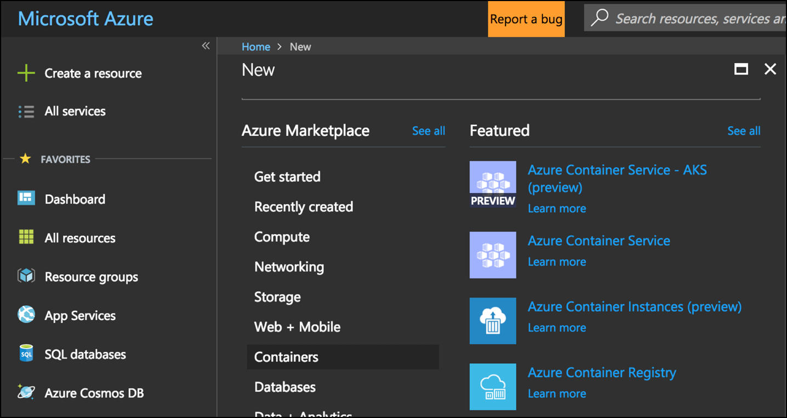
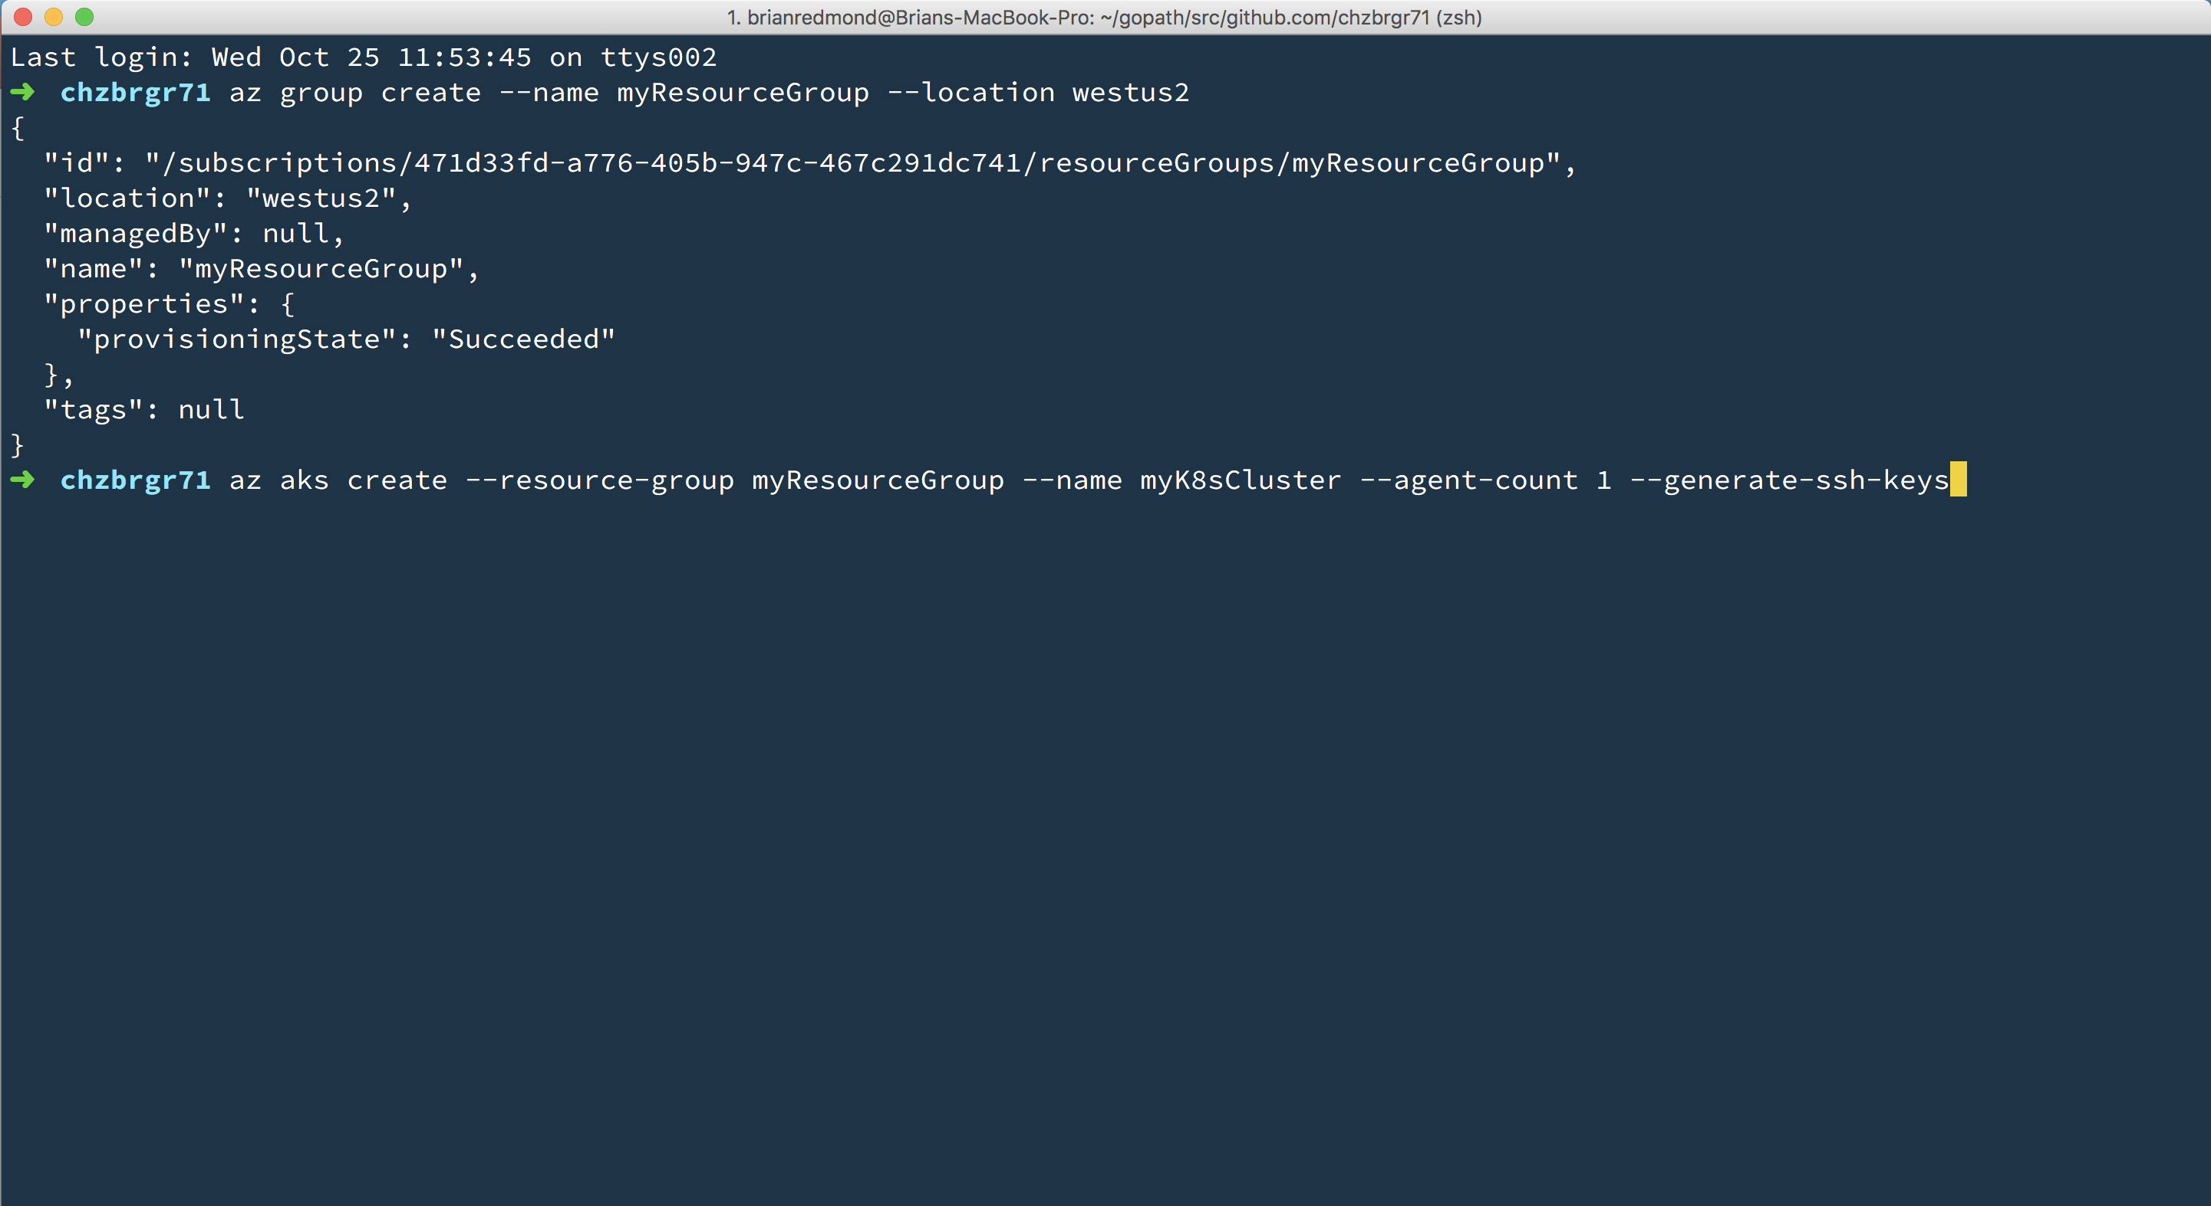
Azure Kubernetes Service (AKS)
Azure Kubernetes Service (AKS)
Create AKS via Portal, Azure CLI, or ARM template
Azure Container Instances (ACI)
Azure Container Registry
Open Service Broker API (OSBA)
Release Automation Tools

Slide 34
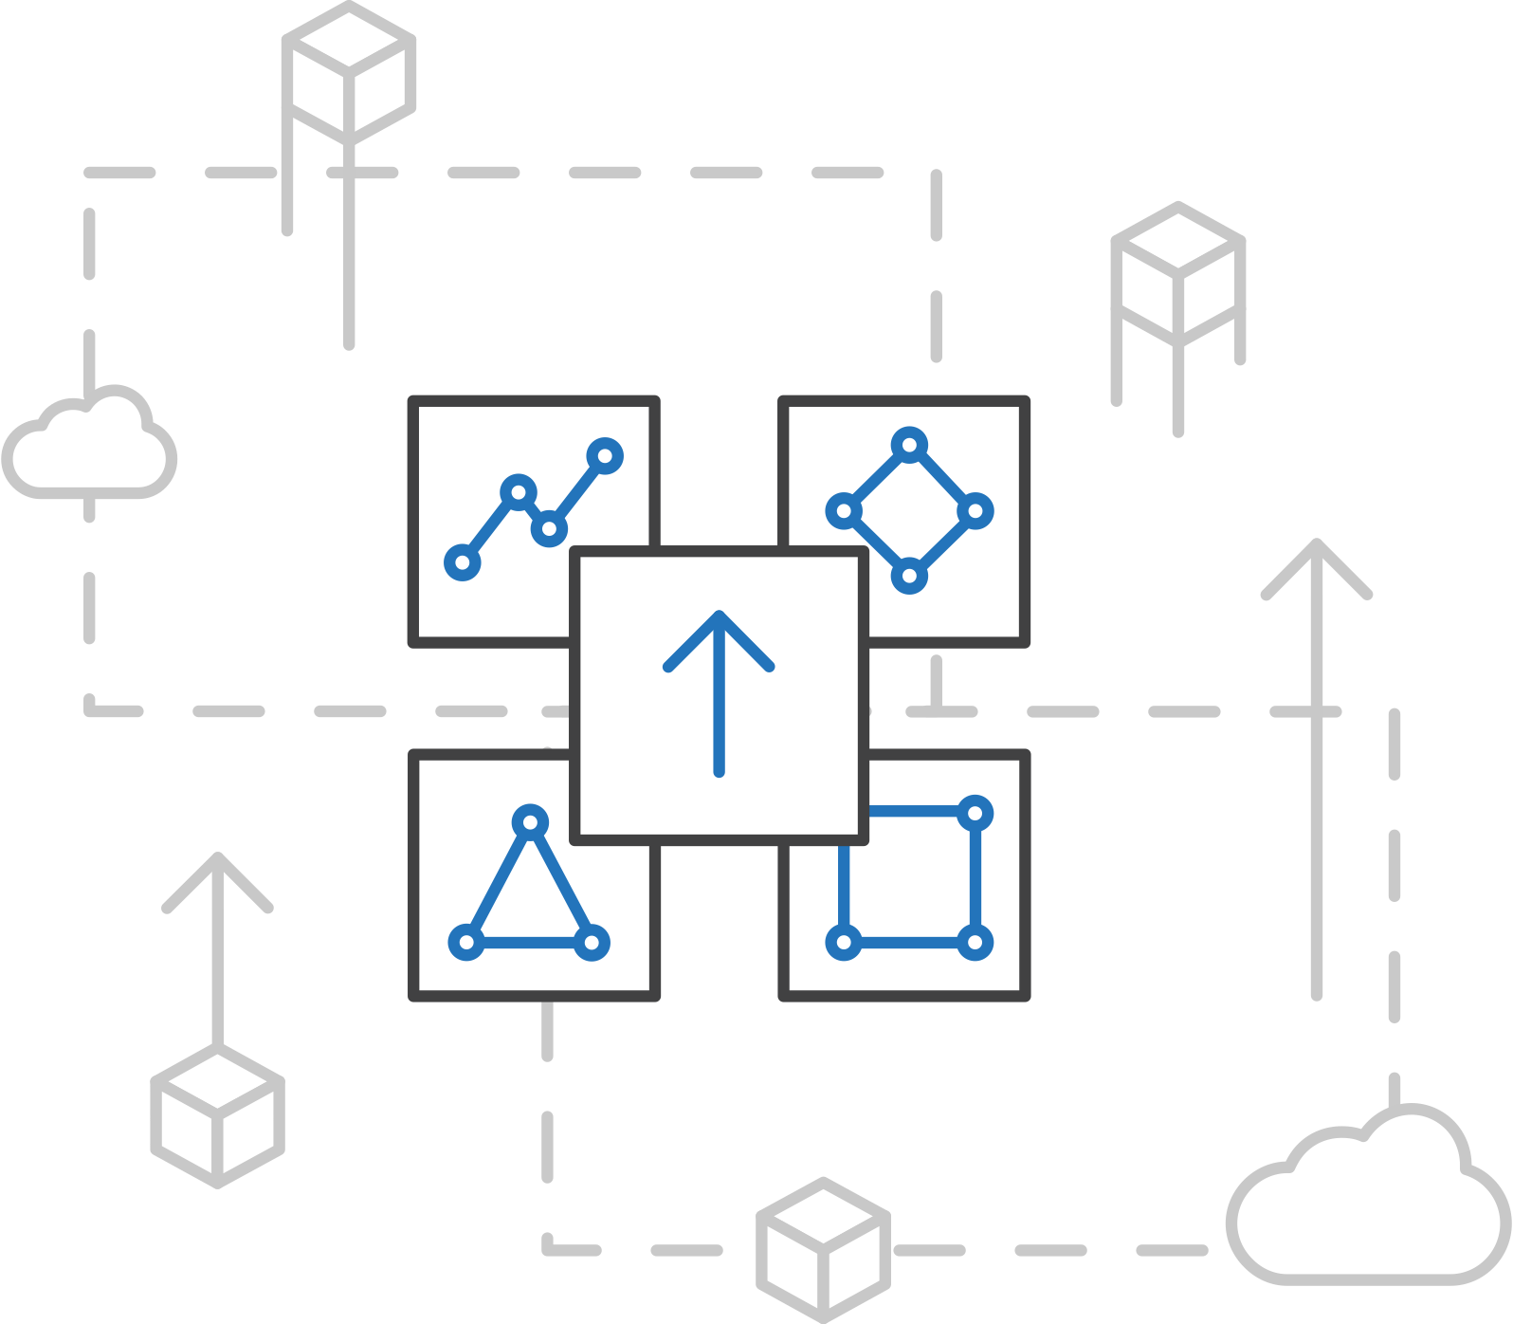
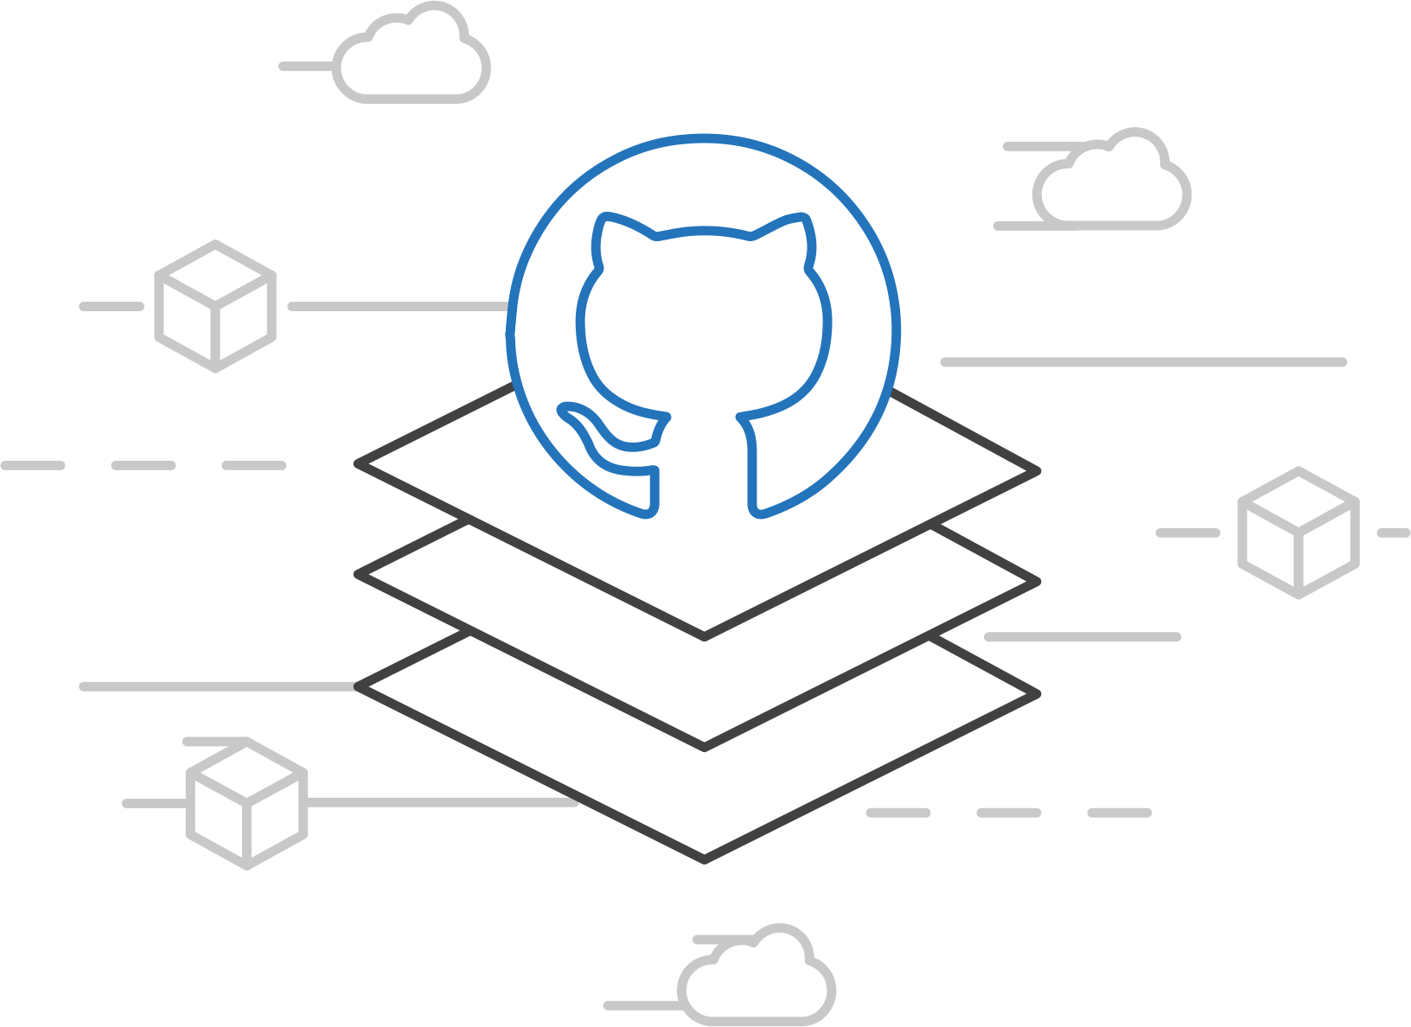
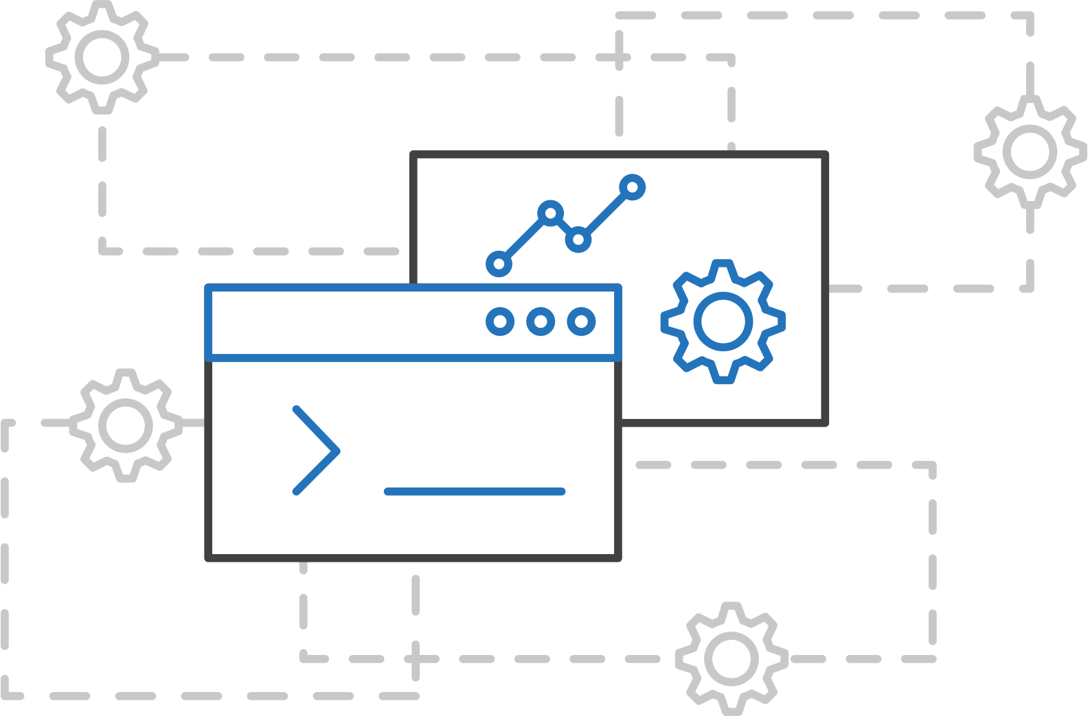
AKS Engine
Azure Kubernetes Service (AKS)
Customized Kubernetes on Azure
(https://github.com/Azure/aks-engine)
Azure Container Instances (ACI)
Azure Container Registry
Open Service Broker API (OSBA)
A proving ground for new features
Enables custom deployments
Available on GitHub
Release Automation Tools

Slide 35
Azure Container Instances (ACI)
Azure Container Registry
Azure Kubernetes Service (AKS)
Release automation tools
Containers 101
Azure container technology
Open Service Broker for Azure (OSBA)
Container orchestration
Azure Container Instances (ACI)

Slide 36
Azure Container Instances (ACI)
Azure Kubernetes Service (AKS)
Azure Container Instances (ACI)
OSBA
App Service
Azure Container Registry (ACR)
Partner services
Azure services
PaaS
Azure Container Registry
OpenShift
SQL Database
Azure Kubernetes Service (AKS)
Service Fabric
Batch
Pivotal Cloud Foundry
Redis Cache
ACS Engine
Open Service Broker API (OSBA)
Docker Enterprise Edition
CosmosDB
Virtual kubelet
Mesosphere DC/OS
And more!
Azure Container Instances (ACI)
Azure Virtual Machines
Virtual Machine Scale Sets (VMSS)
Release Automation Tools
Azure
IaaS

Slide 37
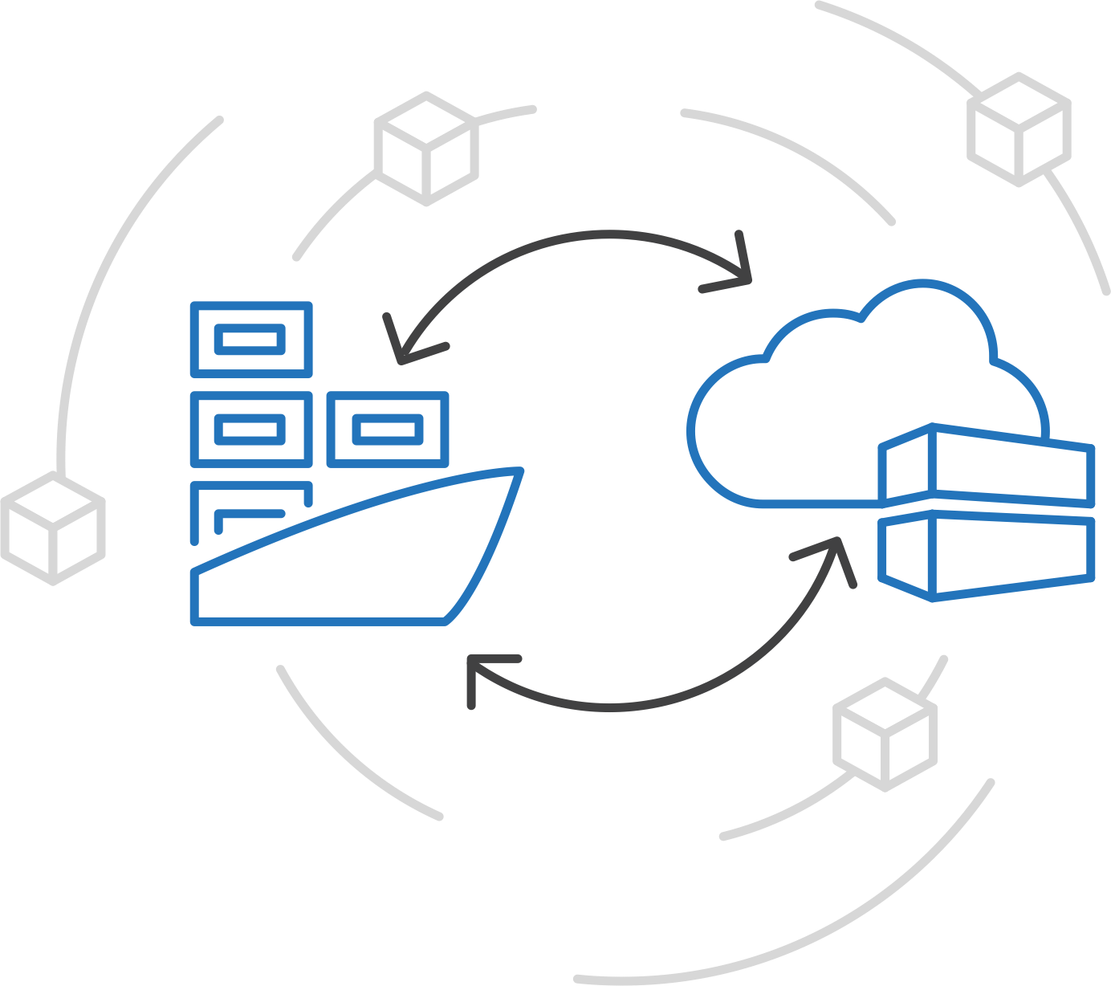
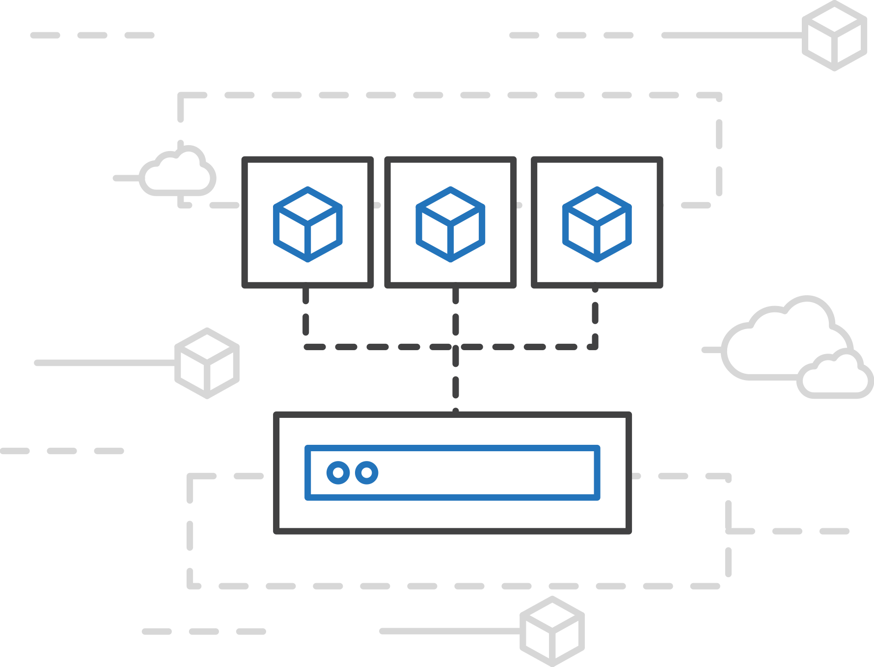
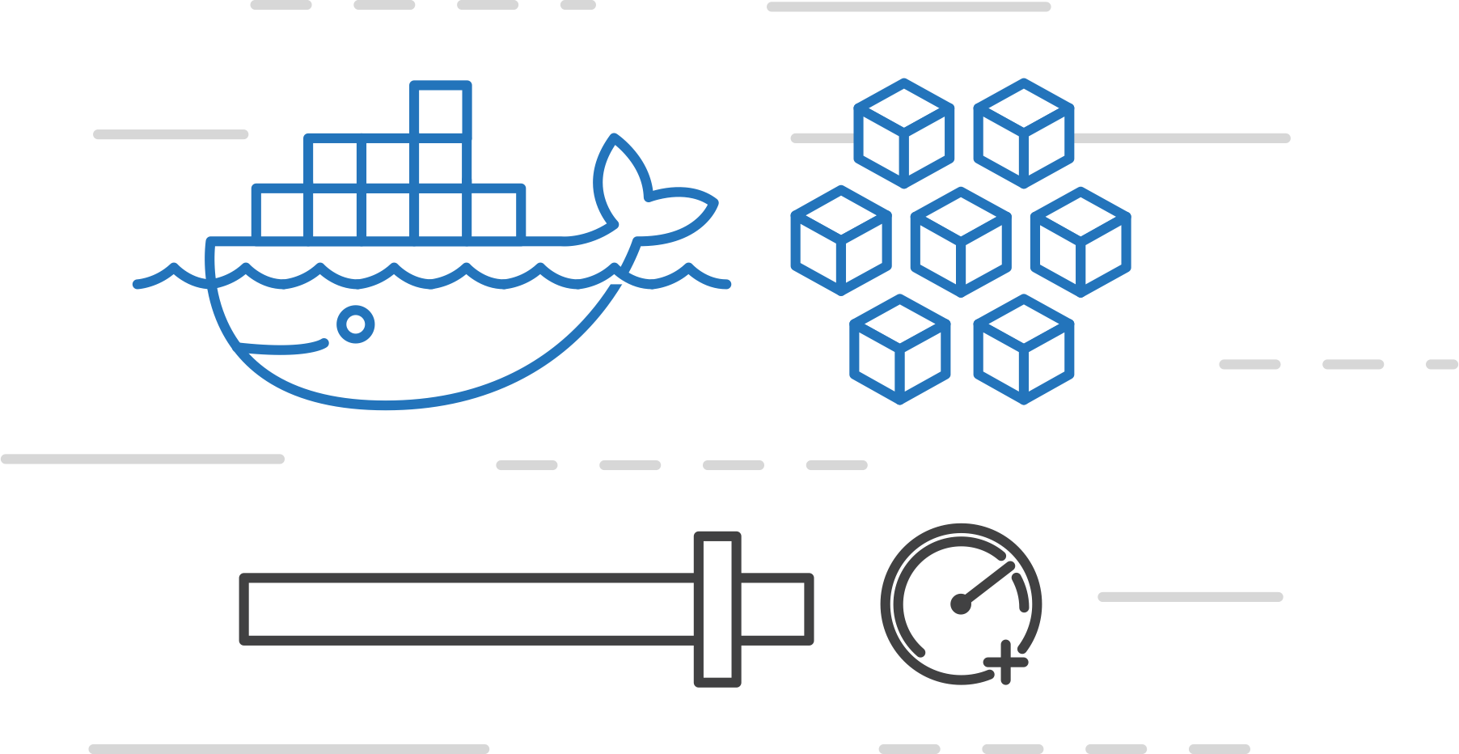
Azure Container Instances (ACI)
Azure Kubernetes Service (AKS)
fastest and simplest way to run a container on Azure
Azure Container Instances (ACI)
Azure Container Registry
Open Service Broker API (OSBA)
Start using containers right away
Cloud-scale container capacity
Hyper-visor isolation
Release Automation Tools

Slide 38
Azure Container Instances (ACI)
Azure Kubernetes Service (AKS)
Get started easily
Azure Container Instances (ACI)
$ az container create --name mycontainer --image microsoft/aci-helloworld --resource-group myResourceGroup --ip-address public
"ipAddress": {
"ip": "52.168.86.133",
"ports": [...]
},
"location": "eastus",
"name": "mycontainer",
"osType": "Linux",
"provisioningState": "Succeeded",
$ curl 52.168.86.133
<html>
<head>
<title>Welcome to Azure Container Instances!</title>
</head>
Azure Container Registry
Open Service Broker API (OSBA)
Release Automation Tools
Notes:
/bin/sh, -c, /mnt/gitclone.sh https://github.com/andyzhangx/k8s-demo.git

Slide 39
Azure Container Instances (ACI)
Azure Kubernetes Service (AKS)
Create an Azure Container Instance quickly
Azure Container Instances (ACI)
Azure Container Registry
Open Service Broker API (OSBA)
Release Automation Tools

Slide 40
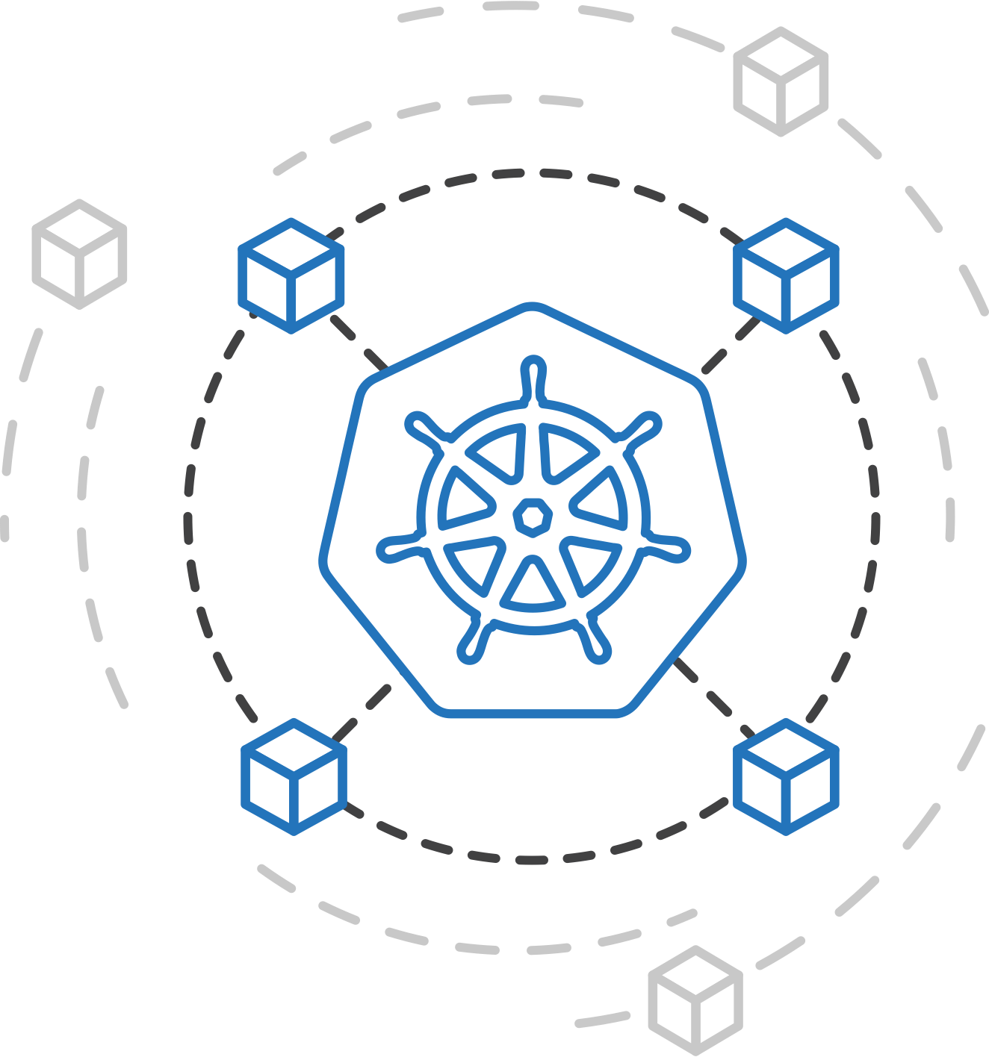
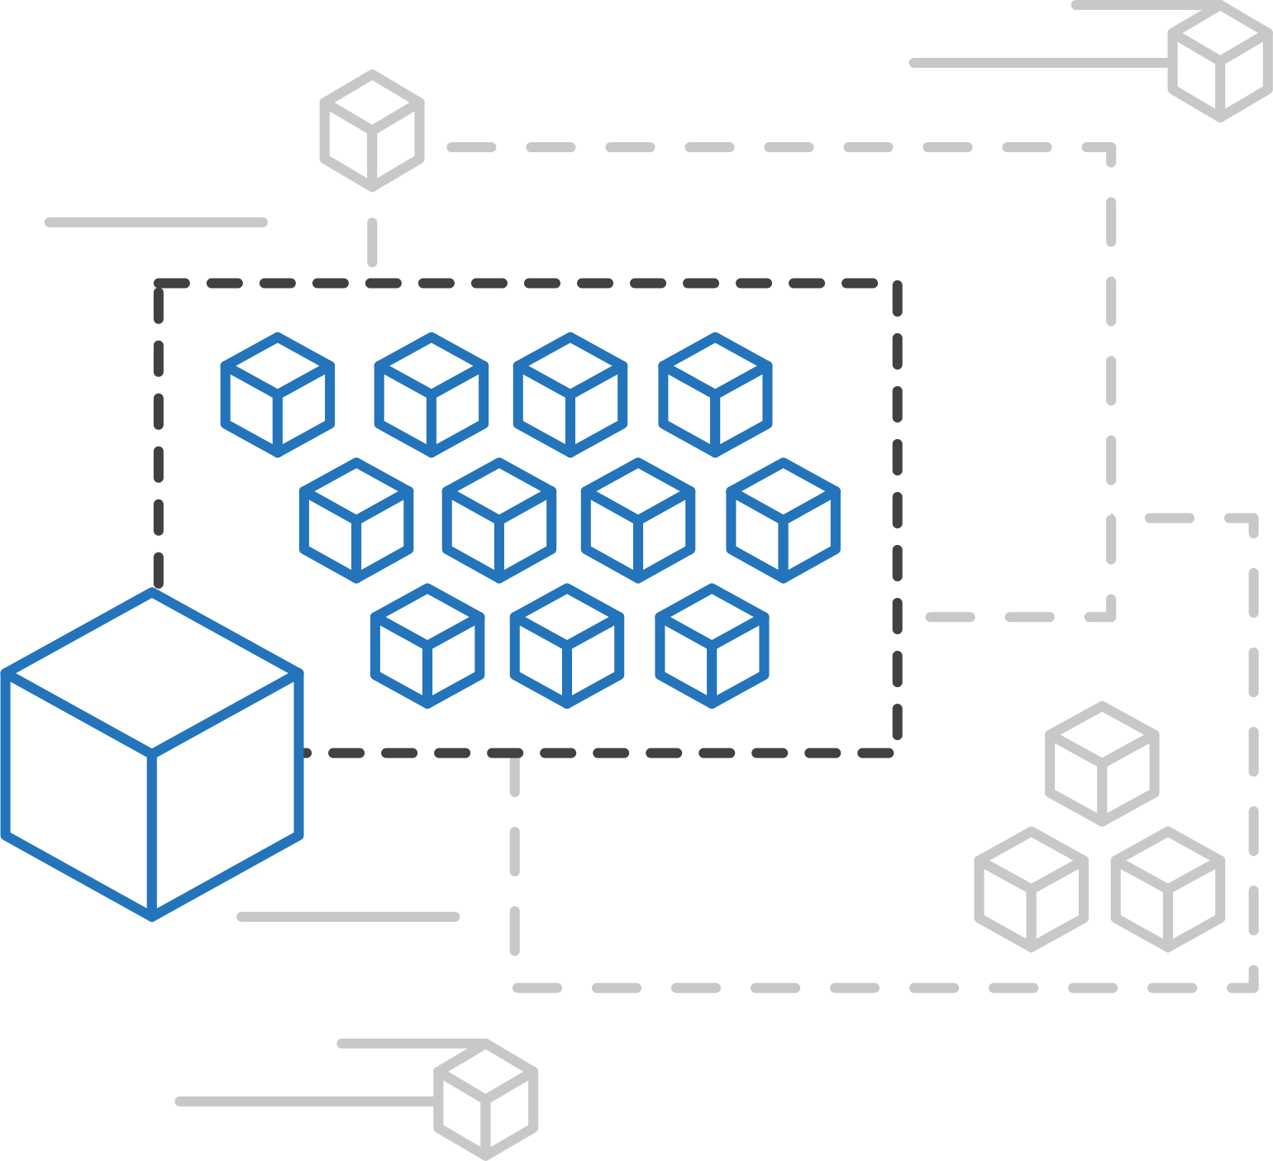
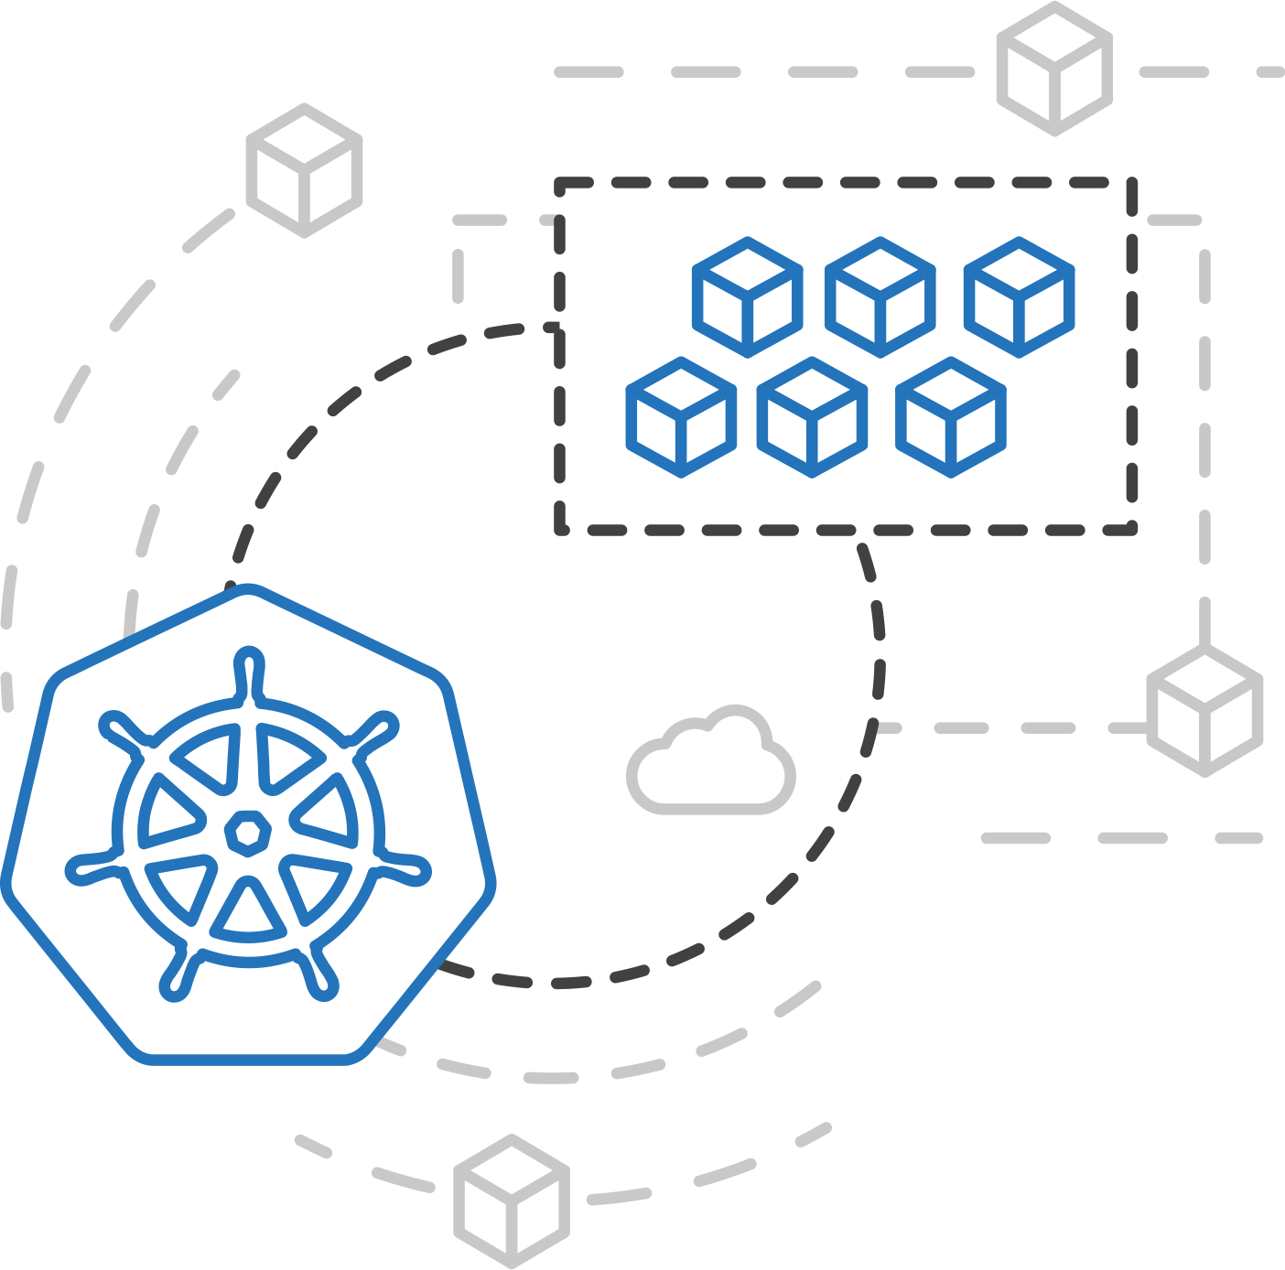
Azure Kubernetes Service (AKS)
Azure Container Instances (ACI)
ACI Connector for Kubernetes
Azure Container Instances (ACI)
Azure Container Registry
Open Service Broker API (OSBA)
Kubernetes provides rich orchestration capabilities
ACI provides infinite container-based scale
The ACI Connector for K8s brings them together
Release Automation Tools

Slide 41
Azure Container Instances (ACI)
Azure Kubernetes Service (AKS)
Bursting with the ACI Connector
Azure Container Instances (ACI)
VM
VM
Pod
Waste
Pod
Pod
Pod
Waste
Pod
Pod
Pod
Pod
Azure Container Registry
Azure Container Instances (ACI)
Pod
Pod
Pod
Pod
Pod
Application architect
Kubernetes control pane
ACI Connector
Pod
Pod
Pod
Pod
Pod
Pod
Pod
Pod
Pod
Pod
Open Service Broker API (OSBA)
Pod
Pod
Pod
Pod
Pod
Deployment/ tasks
Pod
Pod
Pod
Pod
Pod
Infrastructure architect
Release Automation Tools
Pod
Waste
Pod
Pod
Pod
Waste
Pod
Pod
Pod
Pod
VM
VM

Slide 42
Azure Kubernetes Service (AKS)
Azure Container Instances (ACI)
Virtual Kubelet
Azure Container Instances (ACI)
Kubernetes API
Azure Container Registry
Node
Node
Node
Node
virtual kubelet
Kubelet
Kubelet
Kubelet
Kubelet
Open Service Broker API (OSBA)
Release Automation Tools
Typical kubelets implement the pod and container operations for each node as usual.
Virtual kublet registers itself as a “node” and allows developers to program their own behaviors for operations on pods and containers.

Slide 43
Azure Container Registry
Azure Container Registry
Azure Kubernetes Service (AKS)
Release automation tools
Containers 101
Azure container technology
Open Service Broker for Azure (OSBA)
Container orchestration
Azure Container Instances (ACI)

Slide 44
Azure Container Registry
Azure Kubernetes Service (AKS)
Azure Container Instances (ACI)
OSBA
App Service
Azure Container Registry (ACR)
Partner services
Azure services
PaaS
Azure Container Registry
OpenShift
SQL Database
Azure Kubernetes Service (AKS)
Service Fabric
Batch
Pivotal Cloud Foundry
Redis Cache
AKS Engine
Open Service Broker API (OSBA)
Docker Enterprise Edition
CosmosDB
Virtual kubelet
Mesosphere DC/OS
And more!
Azure Container Instances (ACI)
Azure Virtual Machines
Virtual Machine Scale Sets (VMSS)
Release Automation Tools
Azure
IaaS

Slide 45
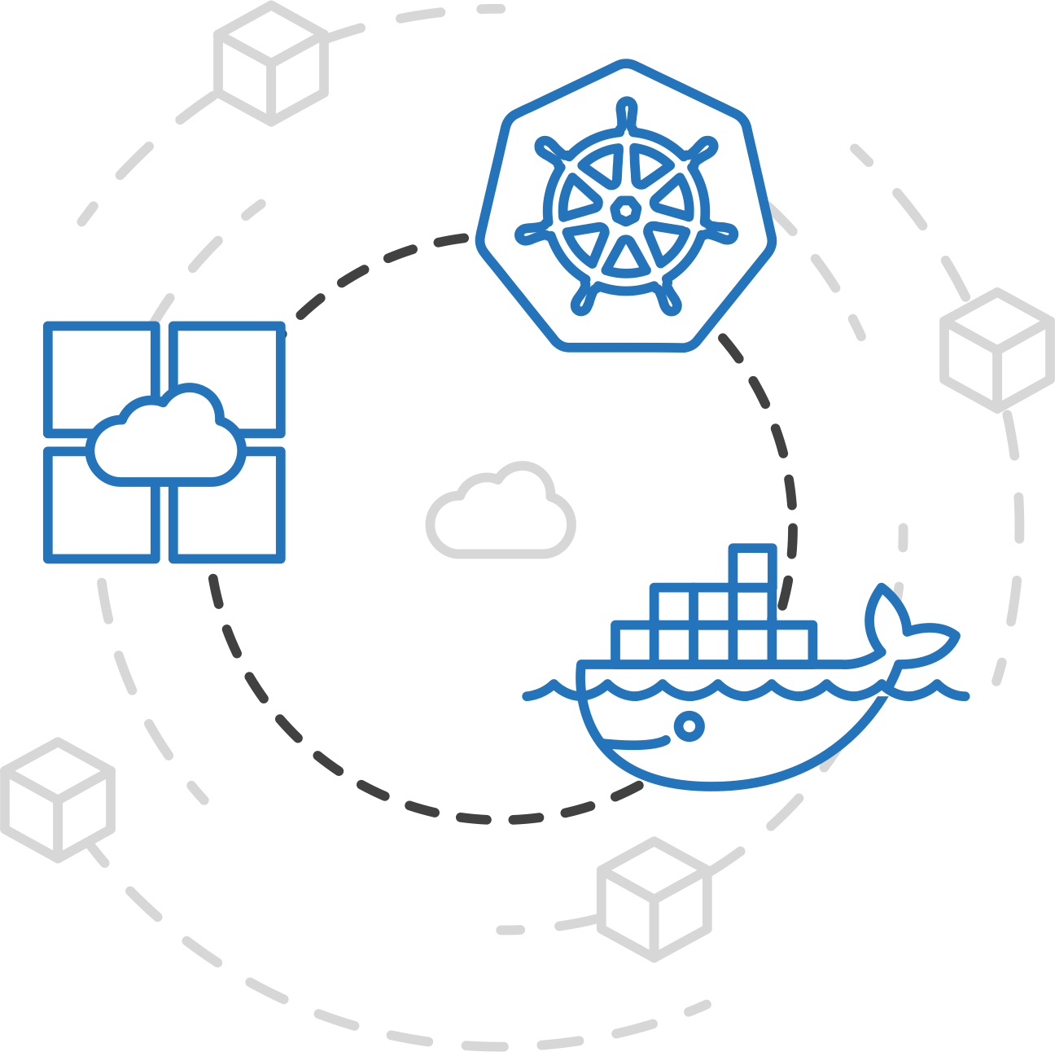
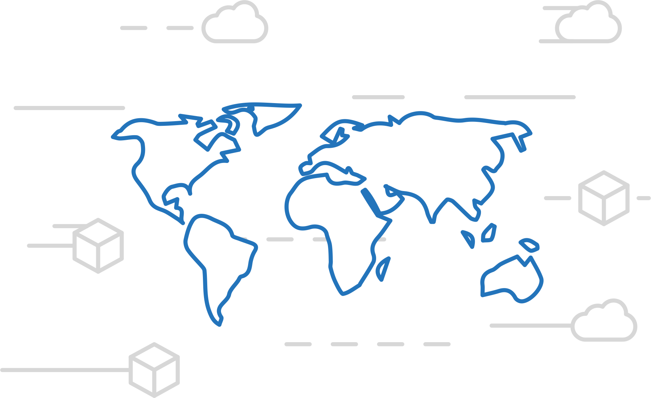
Azure Container Registry
Azure Kubernetes Service (AKS)
Manage a Docker private registry as a first-class Azure resource
Azure Container Instances (ACI)
Azure Container Registry
Open Service Broker API (OSBA)
Manage images for all types of containers
Use familiar, open-source Docker CLI tools
Azure Container Registry geo-replication
Release Automation Tools

Slide 46
Azure Container Registry
Azure Kubernetes Service (AKS)
Create a container in the Registry quickly
Azure Container Instances (ACI)
Azure Container Registry
Open Service Broker API (OSBA)
Release Automation Tools

Slide 47

Open Service Broker for Azure
Azure Container Registry
Azure Kubernetes Service (AKS)
Release automation tools
Containers 101
Azure container technology
Open Service Broker for Azure (OSBA)
Container orchestration
Azure Container Instances (ACI)

Slide 48

Open Service Broker for Azure (OSBA)
Azure Kubernetes Service (AKS)
Azure Container Instances (ACI)
OSBA
App Service
Azure Container Registry (ACR)
Partner services
Azure services
PaaS
Azure Container Registry
OpenShift
SQL Database
Azure Kubernetes Service (AKS)
Service Fabric
Batch
Pivotal Cloud Foundry
Redis Cache
ACS Engine
Open Service Broker API (OSBA)
Docker Enterprise Edition
CosmosDB
Virtual kubelet
Mesosphere DC/OS
And more!
Azure Container Instances (ACI)
Azure Virtual Machines
Virtual Machine Scale Sets (VMSS)
Release Automation Tools
Azure
IaaS

Slide 49
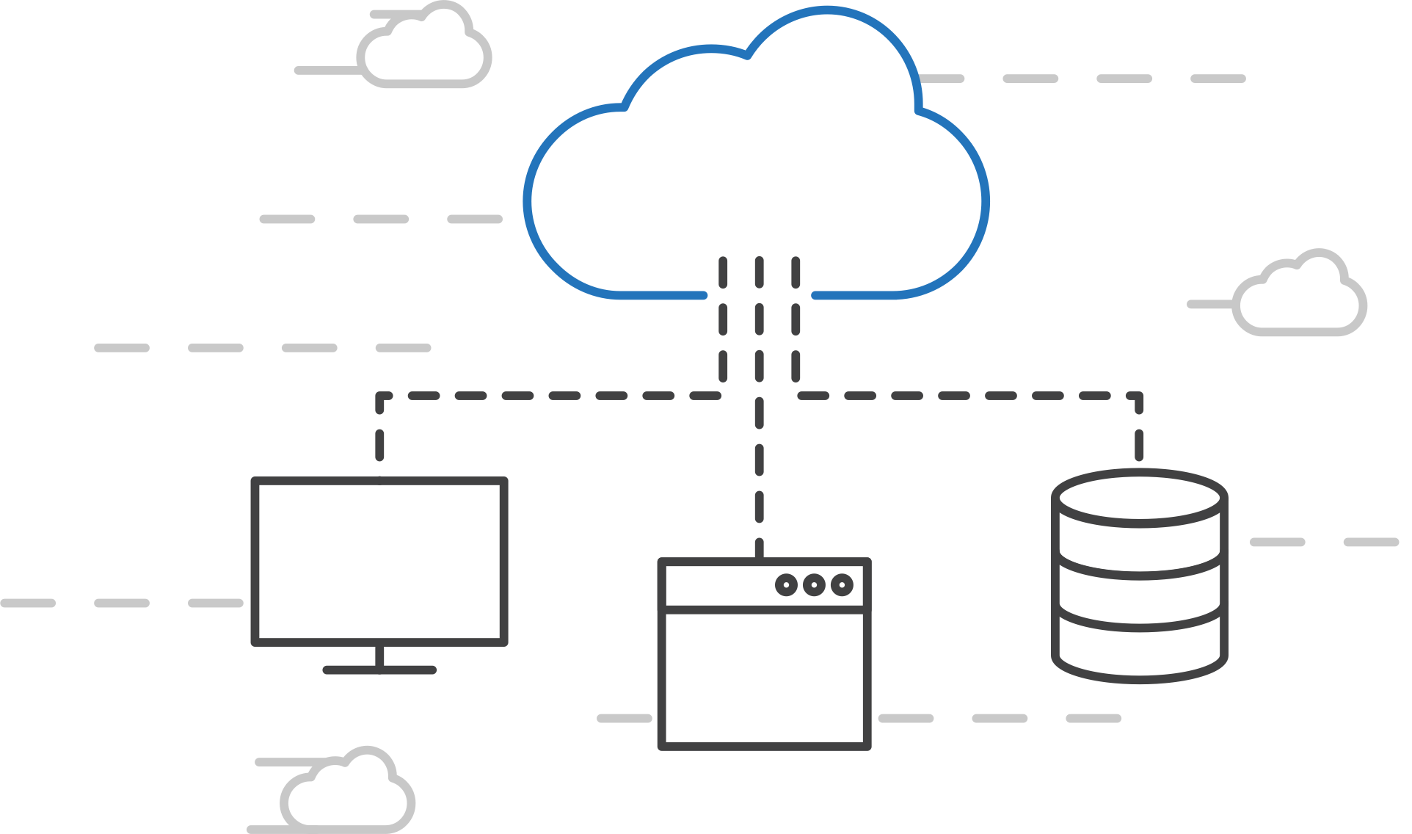
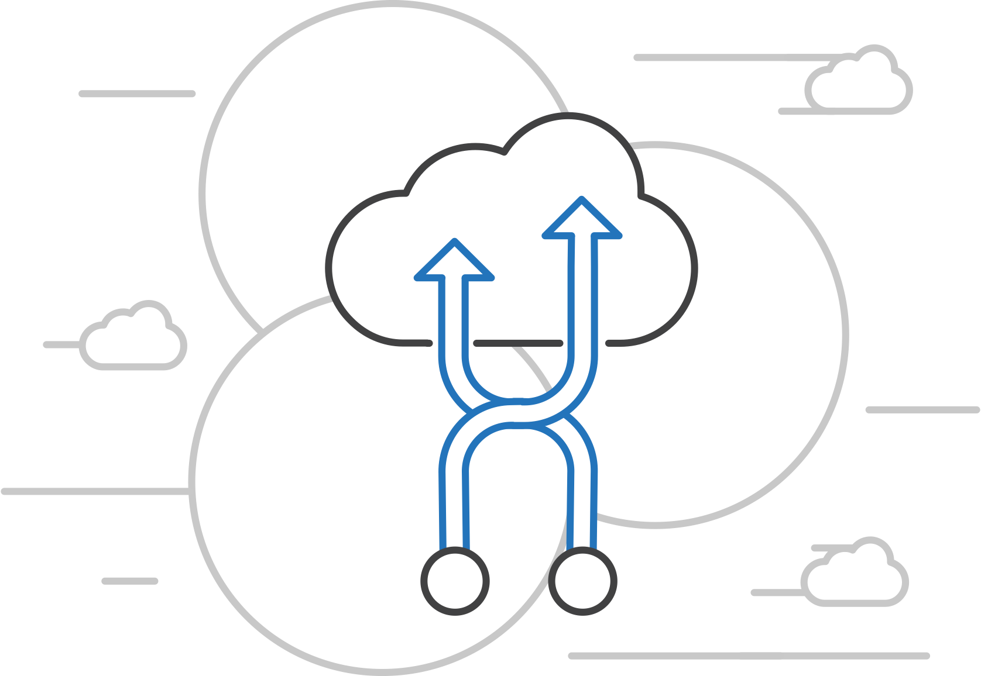
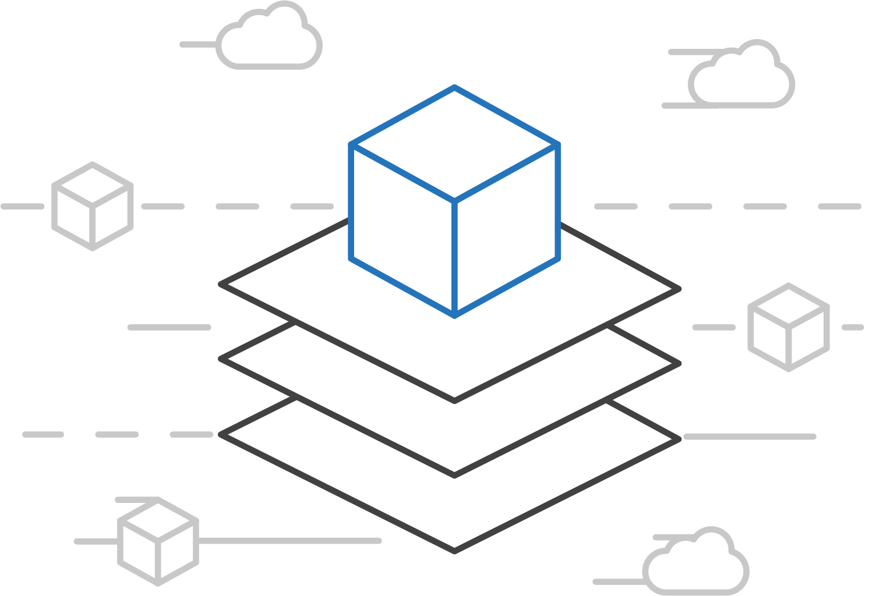
Open Service Broker for Azure (OSBA)
Azure Kubernetes Service (AKS)
Connecting containers to Azure services and platforms
Azure Container Instances (ACI)
Azure Container Registry
Open Service Broker API (OSBA)
A standardized way to connect with Azure services
Simple and flexible service integration
Compatible across numerous platforms
Release Automation Tools

Slide 50
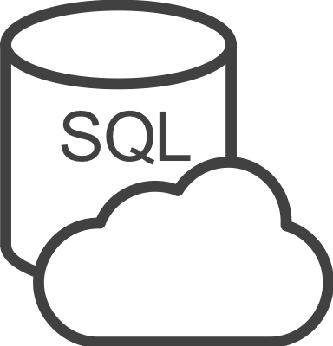




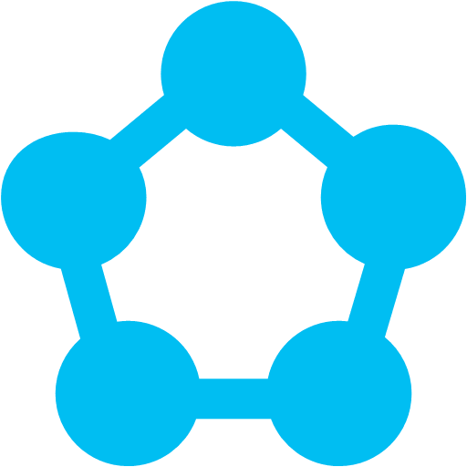
Open Service Broker for Azure (OSBA)
Azure Kubernetes Service (AKS)
An implementation of the Open Service Broker API
Azure Container Instances (ACI)
Azure SQL Database
Redis Cache
CosmosDB
And more!
Azure Container Registry
Open Service Broker for Azure (OSBA)
Open Service Broker API (OSBA)
Release Automation Tools
OpenShift
Cloud Foundry
Service Fabric
Kubernetes (AKS)

Slide 51
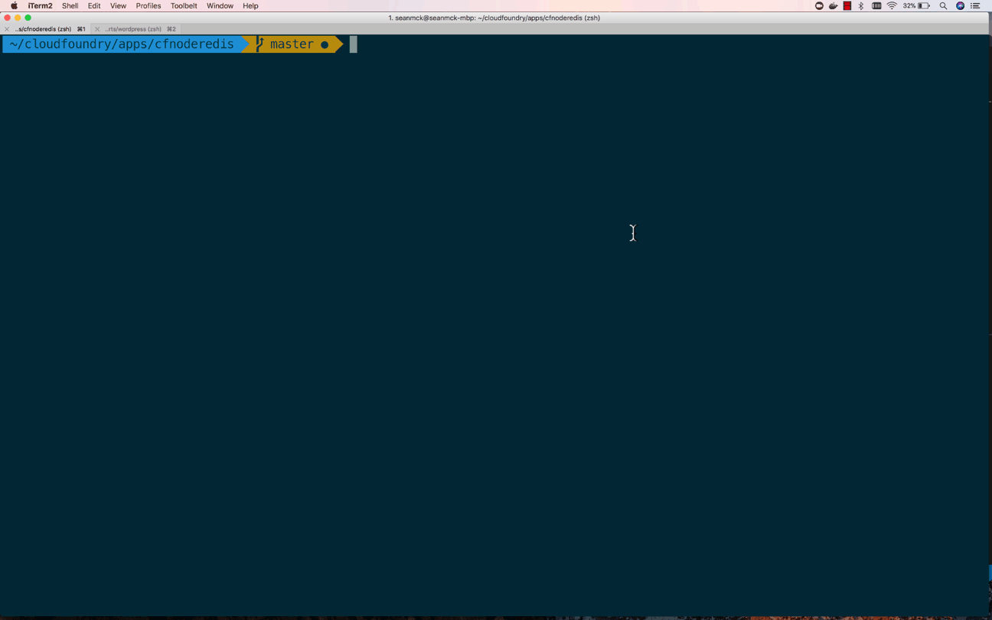
Open Service Broker for Azure (OSBA)
OSBA in action
Azure Container Instances (ACI)
Azure Container Registry
Open Service Broker API (OSBA)
Release Automation Tools

Slide 52
Open Service Broker for Azure (OSBA)
Azure Kubernetes Service (AKS)
Getting started with ease
Azure Container Instances (ACI)
$ helm repo add azure Azure/helm-charts
$ helm install azure/service-broker
$ helm install azure/wordpress
Azure Container Registry
Open Service Broker API (OSBA)
Release Automation Tools

Slide 53
Release automation tools
Azure Container Registry
Azure Kubernetes Service (AKS)
Release automation tools
Containers 101
Azure container technology
Open Service Broker for Azure (OSBA)
Container orchestration
Azure Container Instances (ACI)

Slide 54
DevOps Practices Arrive
Developers: Test, Build, Code, Plan
Operations: Monitor, Release, Deploy, Operate
DevOps Features
Speed of application delivery/updates
Faster time to value
Repeatable/consistent
Automated testing
Traceability of process
Applying developer patterns to infrastructure
Infrastructure as code
Ops teams embracing source control
Centralized monitoring, logging, debugging
CI / CD – key aspect of quality DevOps

Slide 55
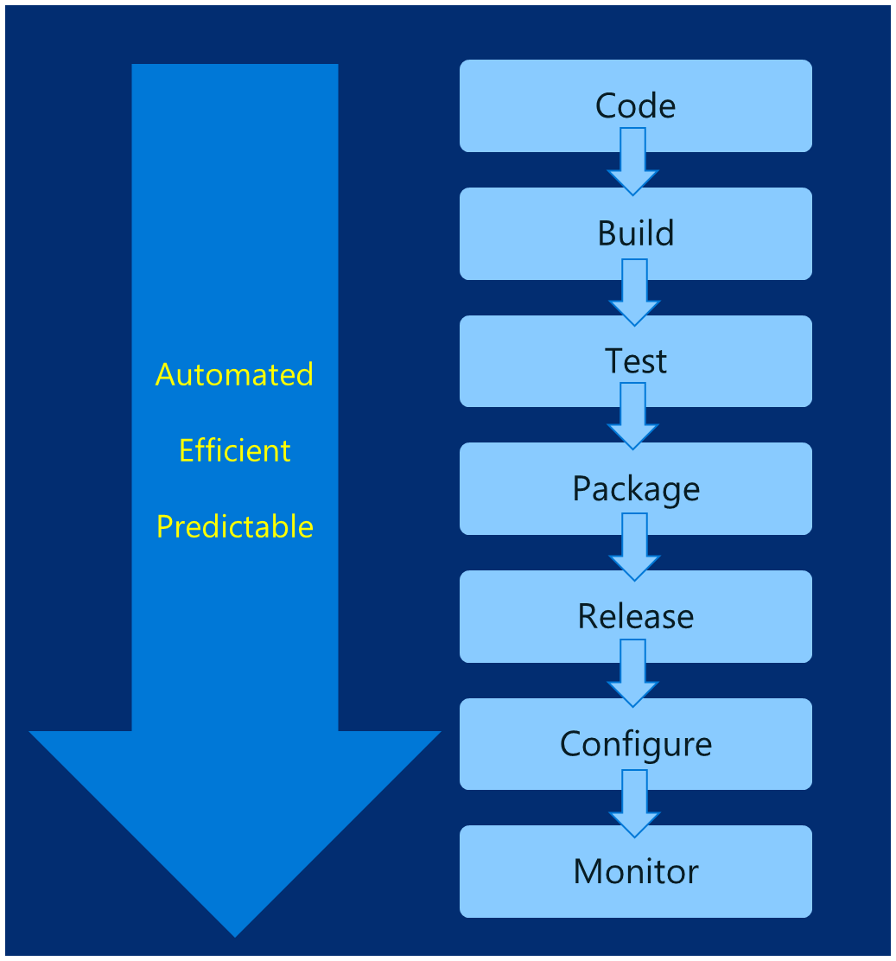
DevOps – Why?
Deploy 200 times more frequently
Go from code check-in to production 2,555 times faster
Recover from failure 24 times faster
Spent 50% less time remediating security challenges
Spent 22% less time on unplanned work
2.2 times more likely to believe their places a great place to work
Source: https://puppet.com/resources/white-paper/2016-state-of-devops-report

Slide 56
Common Toolsets
Jenkins
Azure DevOps Project(formerly VSTS)
Spinnaker and Netflix OSS
Travis
TeamCity
CircleCI
Additional utilities: code quality scanning, security, collaboration, etc.

Slide 57
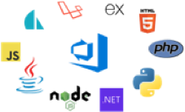

Release automation tools
Azure Kubernetes Service (AKS)
Simplifying the Kubernetes experience
Azure Container Instances (ACI)
Azure Container Registry
The package manager for Kubernetes
Open Service Broker API (OSBA)
Azure DevOps Project
Release Automation Tools
Notes:
CI: continuous integration
CD: continuous delivery or continuous deployment

Slide 58
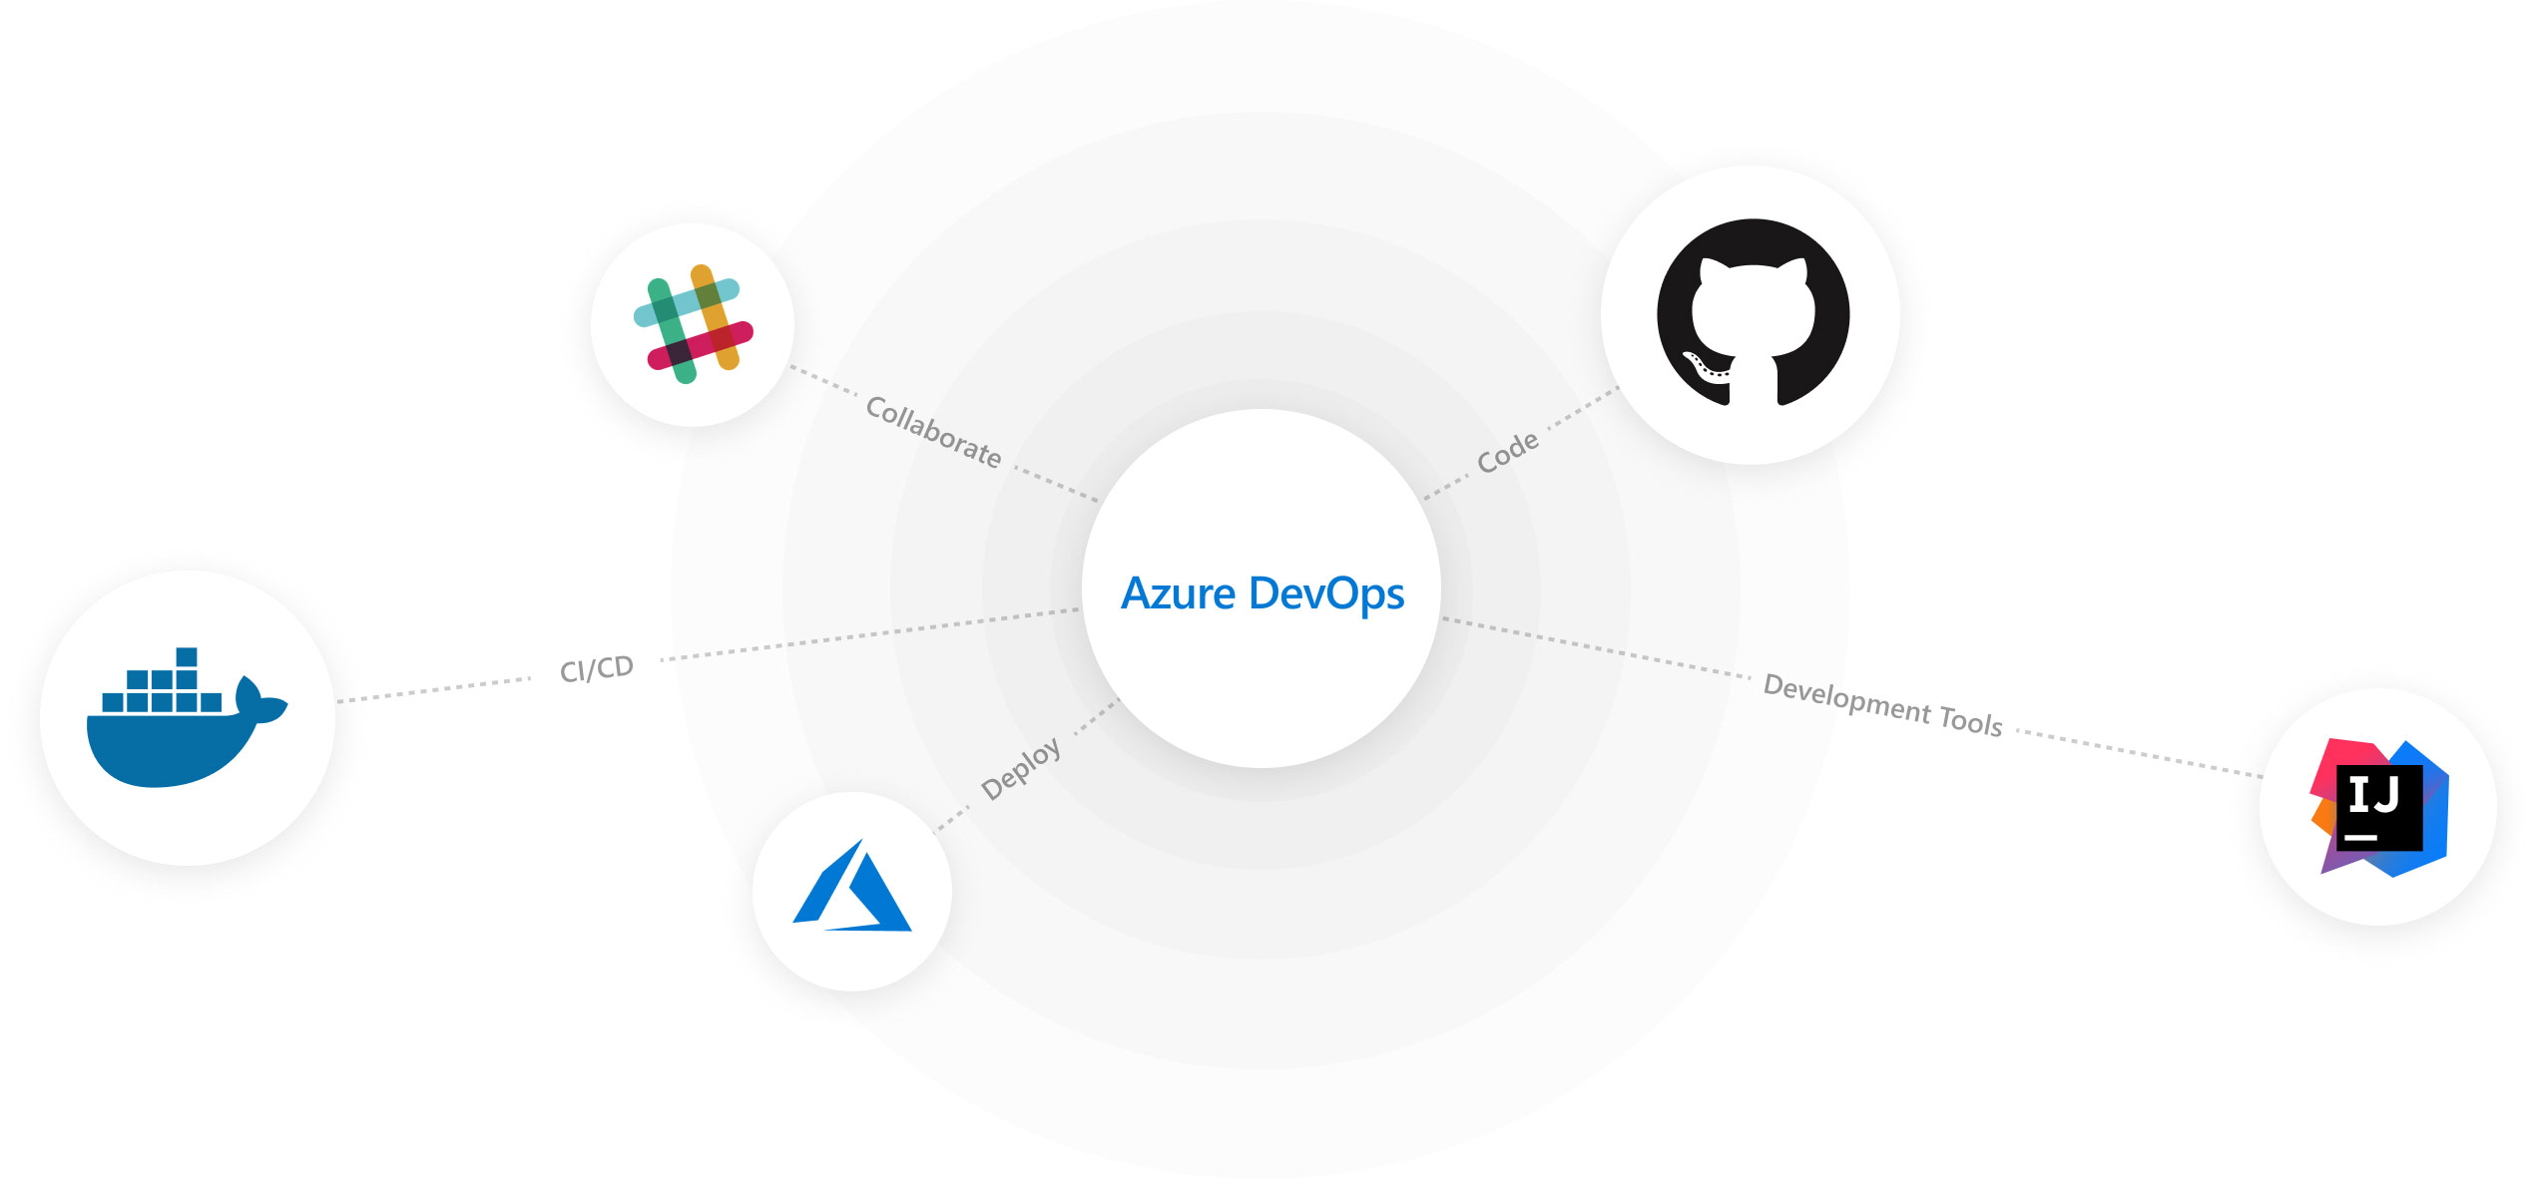
Azure DevOps Project
Azure Kubernetes Service (AKS)
automate setup of an entire continuous integration (CI) and continuous delivery (CD) pipeline to Azure
(https://dev.azure.com)
Azure Container Instances (ACI)
Azure Container Registry
Open Service Broker API (OSBA)
Release Automation Tools
Notes:
https://azure.microsoft.com/en-us/services/devops/

Slide 59
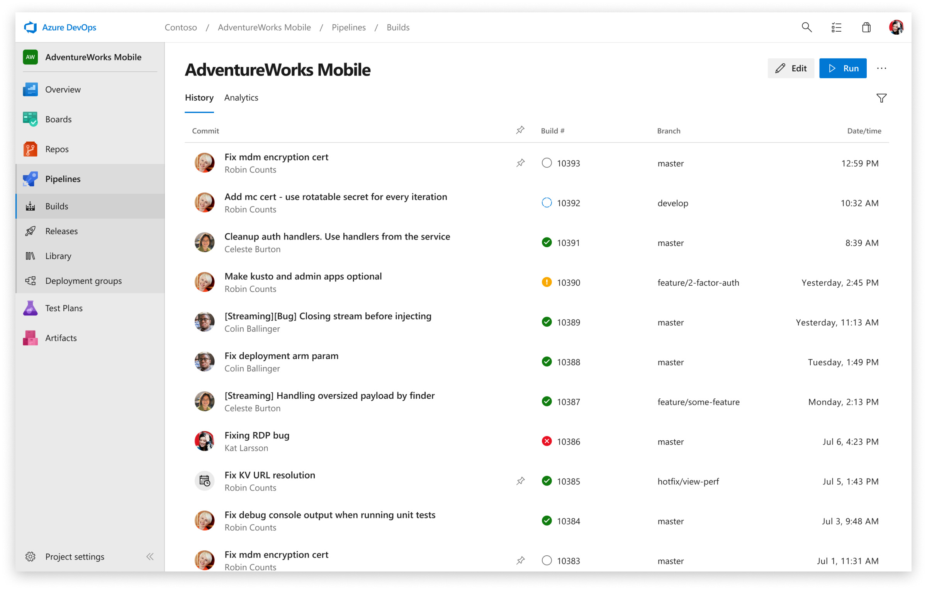
Azure DevOps Project
Azure Kubernetes Service (AKS)
Azure Container Instances (ACI)
Azure Container Registry
Open Service Broker API (OSBA)
Release Automation Tools

Slide 60
Release automation workflow
Azure Kubernetes Service (AKS)
New code directory
Create a code file
Draft creates a dockerfile and a Helm chart for service composition
Azure Container Instances (ACI)
New directory
Add a code file
Draft create
Azure Container Registry
Yes
Does it work?
Git push
Draft commit
Draft up
Open Service Broker API (OSBA)
No
Deploy code container chart
CI/CD
Release Automation Tools
Draft helps devs get running
Draft helps devs and operations iterate on containers and services
Artifacts push to cloud, controlled by CI/CD processes

Slide 61
Release automation workflow
Azure Kubernetes Service (AKS)
Once developers are up and running—or working on a service that is in a complex system—Draft ALSO helps devs ignore artifacts and focus on code
Azure Container Instances (ACI)
git clone
Draft pack-reps
Draft create
Azure Container Registry
Yes
Does it work?
git push
Draft up
Open Service Broker API (OSBA)
No
Debug
CI/CD
Release Automation Tools
Draft helps devs get running
Draft helps devs and operations iterate on containers and services
Artifacts push to cloud, controlled by CI/CD processes

Slide 62
Release automation workflow
Azure Kubernetes Service (AKS)
Create
Azure Container Instances (ACI)
Draft create
Have code?
No
New
Draft page
Azure Container Registry
Yes
Builds image/config. to be deployed
Staged?
Yes
Code
Container
Configuration
Draft create or Draft create-pack (if specific artifacts exist)
Deploy image (AKS)
Deploy to staging
No
Open Service Broker API (OSBA)
Push image
Canary deploy to production
CD: No staging
No
Testing good?
Move to dev cluster
Change
Code
Container
Configuration
Actual development, Draft up/connect iteration
The building process: Brigade, Jenkins, VS TS
Build container
Telemetry successful?
Rollback
Yes
No
2 factor authentication
Push to production as canary
Release Automation Tools
Yes
Git push
Pull code
Rollout
Code/artifacts ready

Slide 63
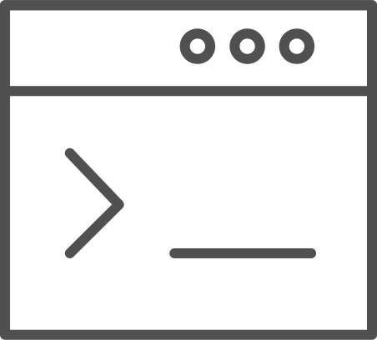
Draft
Azure Kubernetes Service (AKS)
Simple app development and deployment – into any Kubernetes cluster
Azure Container Instances (ACI)
Azure Container Registry
Open Service Broker API (OSBA)
Simplified development
Using two simple commands, developers can now begin hacking on container-based applications without requiring Docker or even installing Kubernetes themselves
Language support
Draft detects which language your app is written in, and then uses packs to generate a Dockerfile and Helm Chart with the best practices for that language
Release Automation Tools

Slide 64

Draft
Azure Container Service (AKS)
Draft in action
Azure Container Instances (ACI)
Azure Container Registry
Open Service Broker API (OSBA)
Release Automation Tools

Slide 65
Helm
Azure Kubernetes Service (AKS)
The best way to find, share, and use software built for Kubernetes
(https://github.com/helm/helm)
Azure Container Instances (ACI)
Azure Container Registry
Open Service Broker API (OSBA)
Manage complexity
Charts can describe complex apps; provide repeatable app installs, and serve as a single point of authority
Easy updates
Take the pain out of updates with in-place upgrades and custom hooks
Simple sharing
Charts are easy to version, share, and host on public or private servers
Rollbacks
Use helm rollout to roll back to an older version of a release with ease
Release Automation Tools

Slide 66

Helm
Azure Kubernetes Service (AKS)
Helm Charts helps you define, install, and upgrade even the most complex Kubernetes application
Azure Container Instances (ACI)
services
ci
db
Azure Container Registry
load balancer
custom
…
Chart.yml
Open Service Broker API (OSBA)
Release Automation Tools
Notes:
Wordpress: mysql + web + controller + load balancer

Slide 67
Helm
Azure Kubernetes Service (AKS)
Helm Charts helps you define, install, and upgrade even the most complex Kubernetes application
Azure Container Instances (ACI)
$ helm init
$ helm repo add bitnami https://charts.bitnami.com/bitnami
$ helm install bitnami/wordpress
Azure Container Registry
Open Service Broker API (OSBA)
Release Automation Tools
Notes:
Wordpress: mysql + web + controller + load balancer

Slide 68
Helm Charts
Application definition
Consists of:
Metadata
Kubernetes resource definitions
Configuration
Documentation
Stored in chart repository
Any HTTP server that can house YAML/tar files (Azure, GitHub pages, etc.)
Public repo with community supported charts (eg – Jenkins, Mongo, etc.)
Helm (CLI) + Tiller (sever side)
Release: Instance of chart + values -> Kubernetes

Slide 69
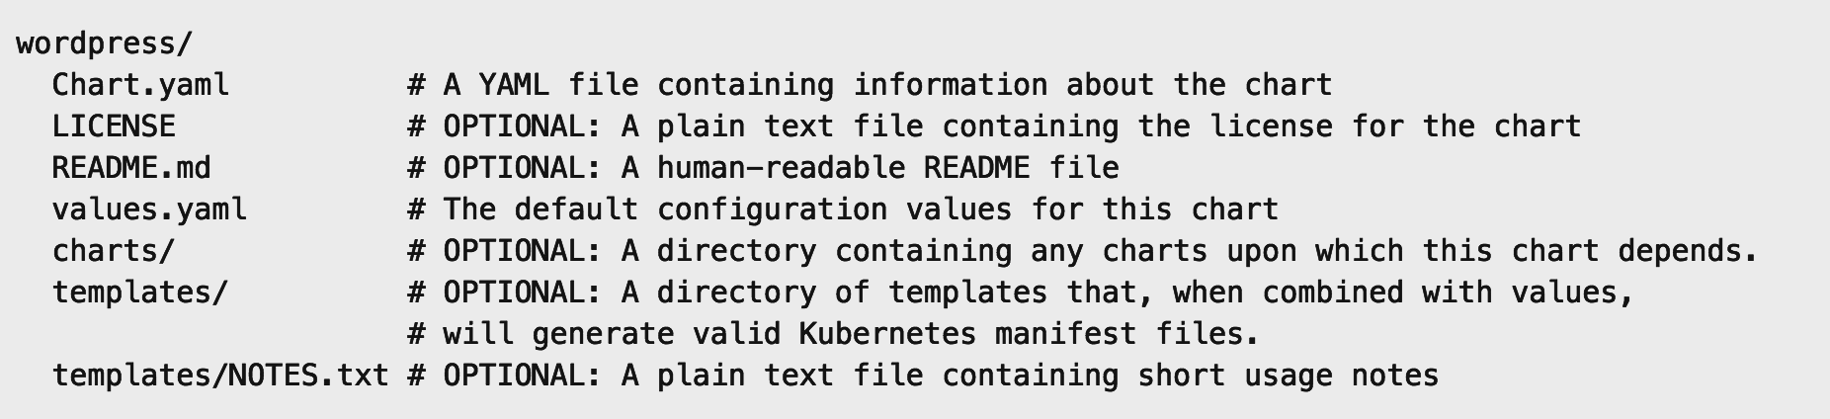
Chart structure
Layout
Helm expects a strict chart structure

Slide 70
Helm values.yaml
The knobs and dials:
A values.yaml file provided with the chart that contains default values
Use -f to provide your own values overrides
Use --set to override individual values

Slide 71
Brigade
Azure Kubernetes Service (AKS)
Run scriptable, automated tasks in the cloud — as part of your Kubernetes cluster
Azure Container Instances (ACI)
Azure Container Registry
Open Service Broker API (OSBA)
Simple, powerful pipes
Each project gets a brigade.js config file, which is where you can write dynamic, interwoven pipelines and tasks for your Kubernetes cluster
Runs inside your cluster
By running Brigade as a service inside your Kubernetes cluster, you can harness the power of millions of available Docker images
Release Automation Tools

Slide 72
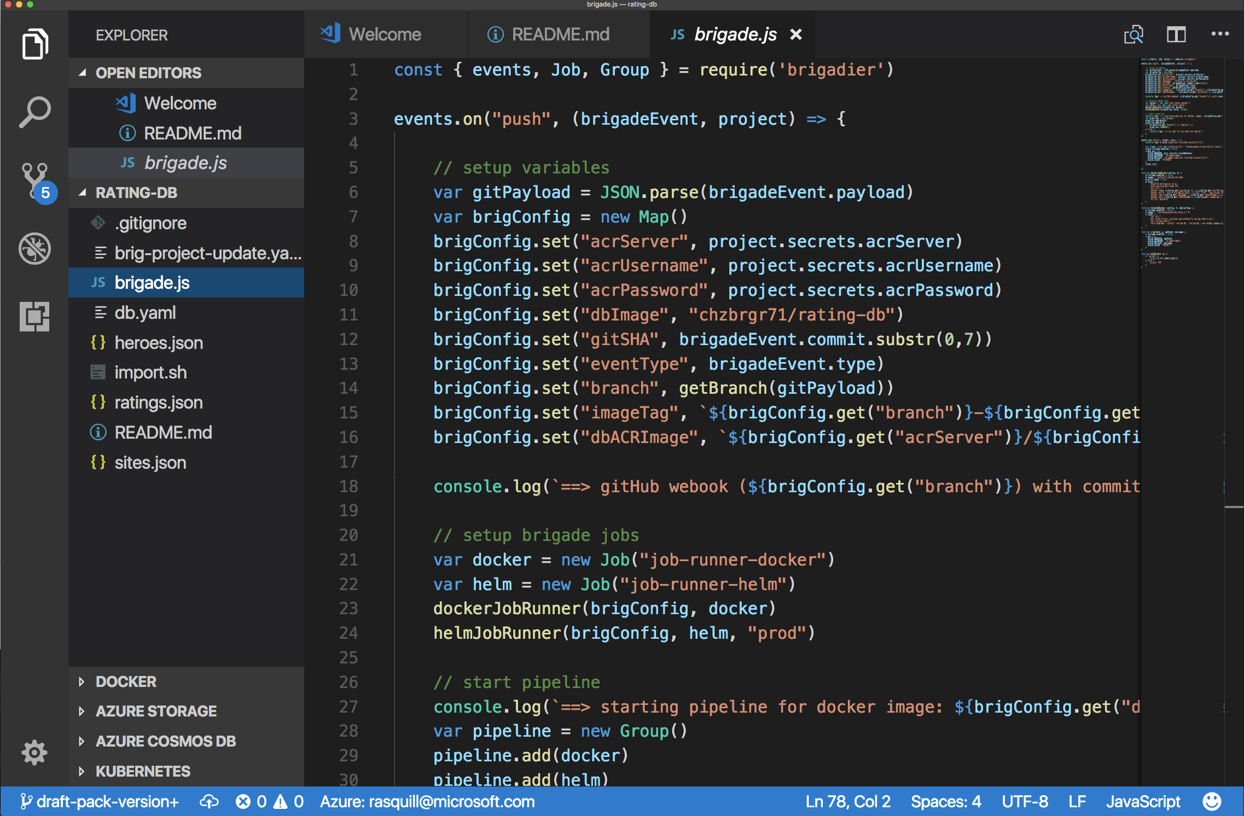
Brigade
Azure Kubernetes Service (AKS)
Brigade in action
Azure Container Instances (ACI)
Azure Container Registry
Open Service Broker API (OSBA)
Release Automation Tools

Slide 73
Kashti
Azure Kubernetes Service (AKS)
A simple UI to display build results and logs
Azure Container Instances (ACI)
Azure Container Registry
Simple visualizations
A web dashboard for Brigade, helping to easily visualize and inspect your Brigade builds
Driving deep insights
Make Brigade DevOps workflows— projects, scripts, and jobs—and their events visible instantly
Open Service Broker API (OSBA)
Release Automation Tools

Slide 74
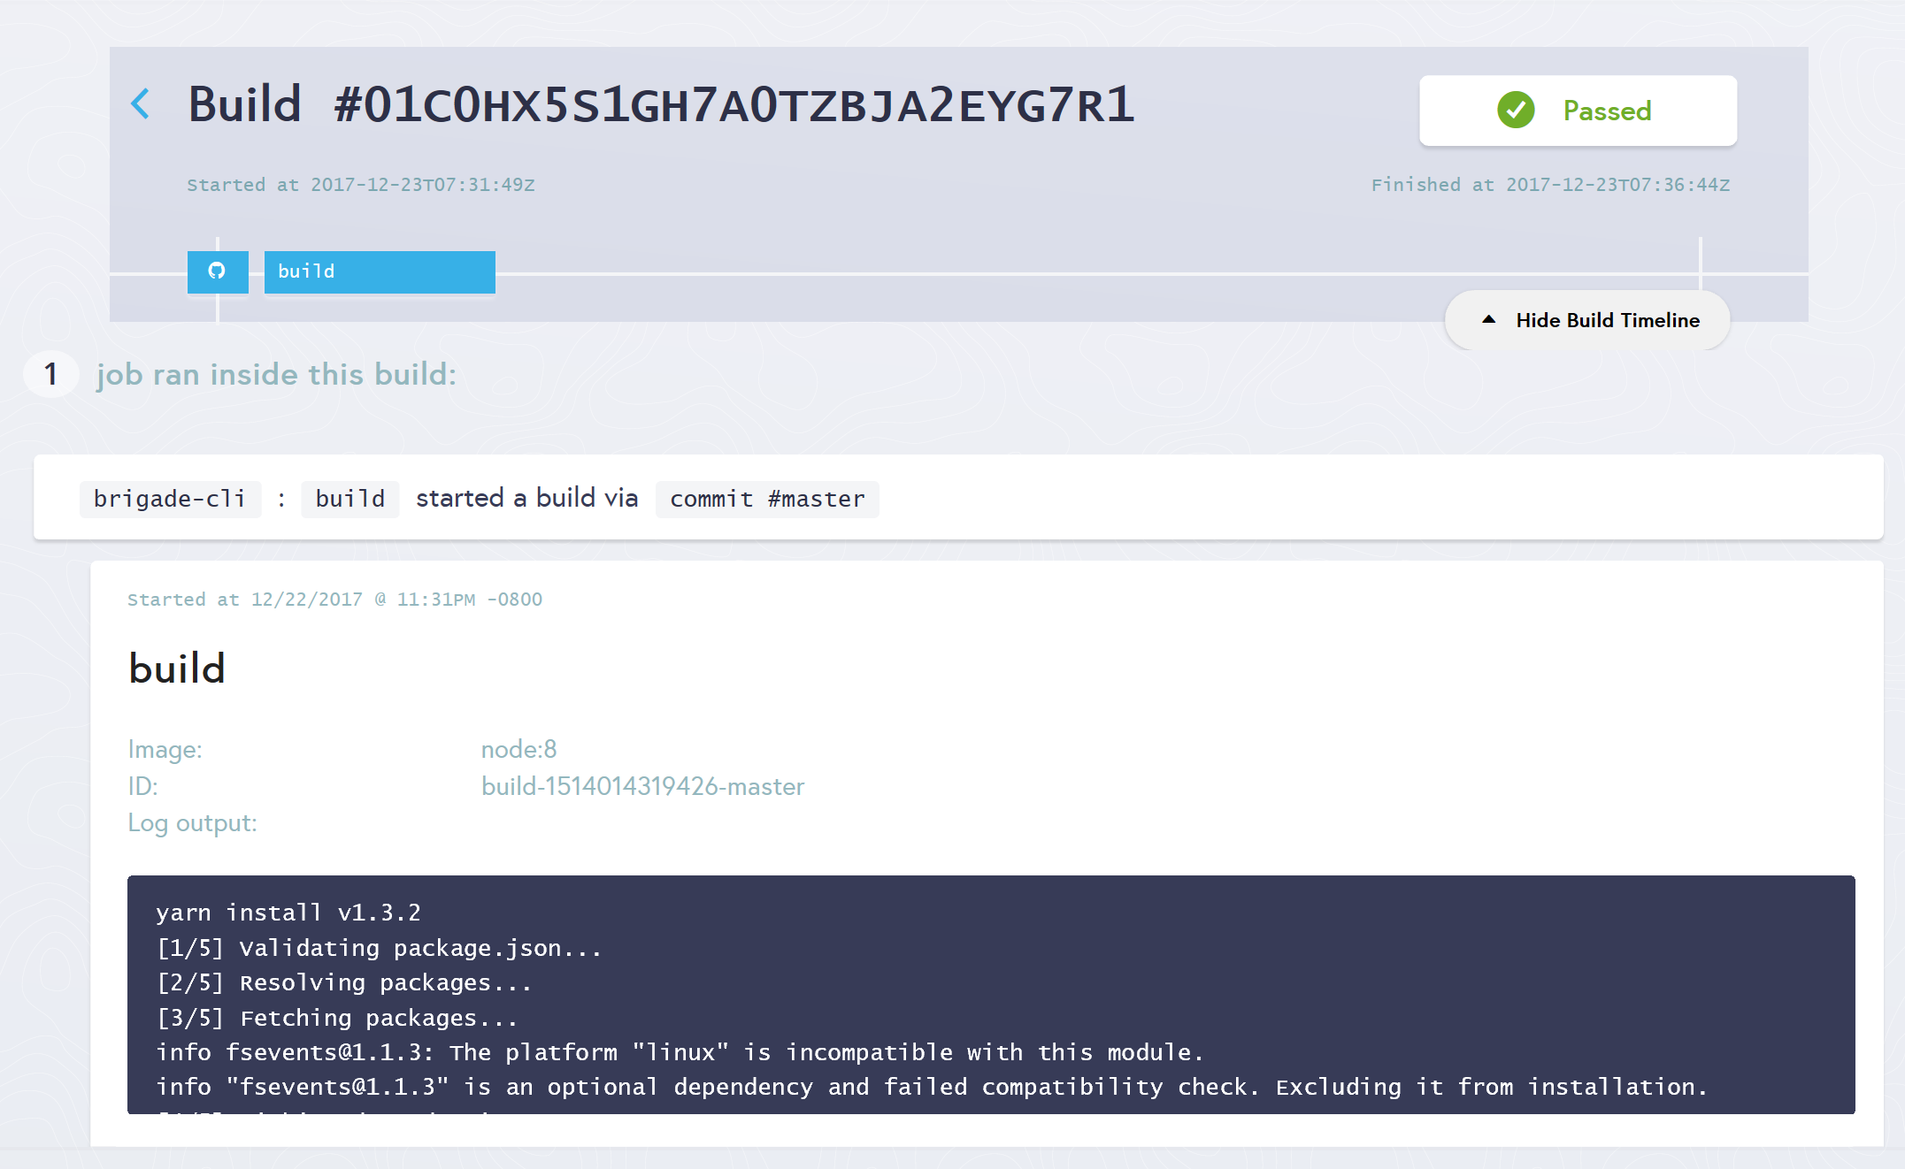
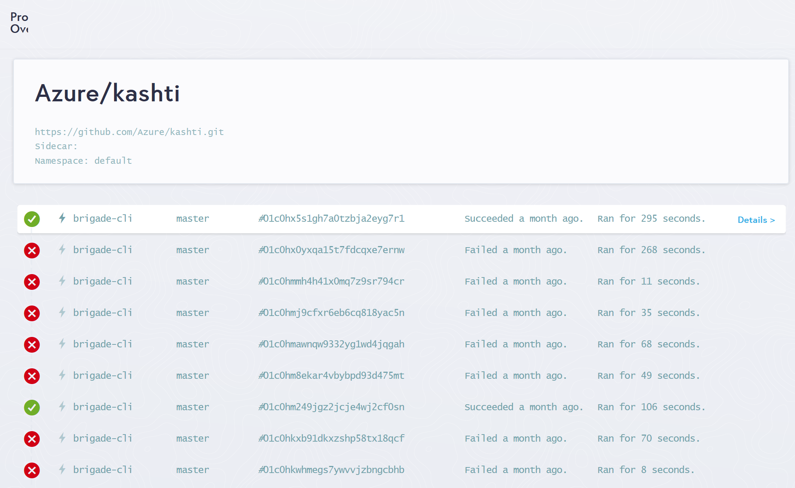
Kashti
Azure Kubernetes Service (AKS)
Dashboards for Brigade pipelines
Azure Container Instances (ACI)
Azure Container Registry
Open Service Broker API (OSBA)
Release Automation Tools
Builds dashboard
Events log

Slide 75
Reference
https://docs.microsoft.com/zh-cn/azure/aks/
AKS on Azure China is in Public Preview
https://aka.ms/aks/get-started-china
Get the slides:
https://github.com/andyzhangx/demo/blob/master/aks-overview.pptx

Slide 76

Questions?

Slide 77

Open source community
Azure Container Registry
Open source community
Azure Kubernetes Service (AKS)
Release automation tools
Containers 101
Getting started
Azure container technology
Open Service Broker for Azure (OSBA)
Customer success stories
Container orchestration
Azure Container Instances (ACI)

Slide 78

Community culture
Open source container code contributions
Numerous open source project builds
Open source community leadership

Slide 79

Customer success stories
Azure Container Registry
Open source community
Azure Kubernetes Service (AKS)
Release automation tools
Containers 101
Getting started
Azure container technology
Open Service Broker for Azure (OSBA)
Customer success stories
Container orchestration
Azure Container Instances (ACI)

Slide 80


Energy company electrifies pace of innovation and expansion
Ambit Energy provides electricity and natural-gas services in deregulated markets around the world. It uses technology as a competitive differentiator, employing microservices, DevOps, and continuous deployment to speed software development. To stand up infrastructure just as quickly, Ambit uses Microsoft Azure services such as Azure Container Service, together with infrastructure as code and open source technologies, to completely automate infrastructure provisioning. By implementing Azure, Ambit can move dramatically faster to enhance its services and enter new markets. Infrastructure redundancy is flexible and worry-free. And costs are 22 percent lower, which helps Ambit compete in the crowded electricity market. Because Ambit’s cloud journey is gradual, it appreciates the fact that Azure is a great hybrid-cloud enabler, connecting easily to Ambit datacenters.
Products and services
Organization size
Industry
Country
Business need
Microsoft Azure Container Service
1,000 employees
Power and utilities
United States
Optimize operational efficiency

Slide 81


Siemens Health leverages technology to connect medical devices to the cloud through AKS
Digitization and networking between healthcare providers and software development companies are essential to value-based care. Moving from the development of value-added services into becoming more of a platform provider, it became important for Siemens to adopt a microservices approach to application delivery. To that end, Siemens adopted Azure Container Service (AKS) to run their microservices-based apps. AKS puts Siemens in a position not only to deploy business logic in Docker containers—including the orchestration—but also enables them to use an applicant gateway and API management to manage exposure, control, and to meter the access continuously. With their cloud-based development approach, Siemens has driven newfound product development agility. This project is already having a positive impact within the healthcare industry.
Products and services
Organization size
Industry
Country
Business need
Microsoft Azure Container Service
100,000+ employees
Healthcare
Germany
Faster application development

Slide 82
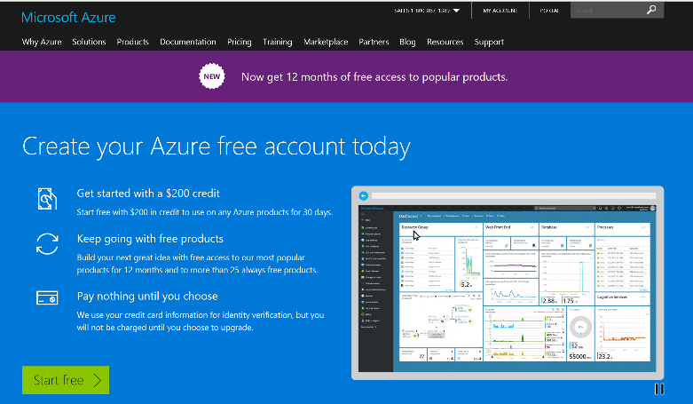
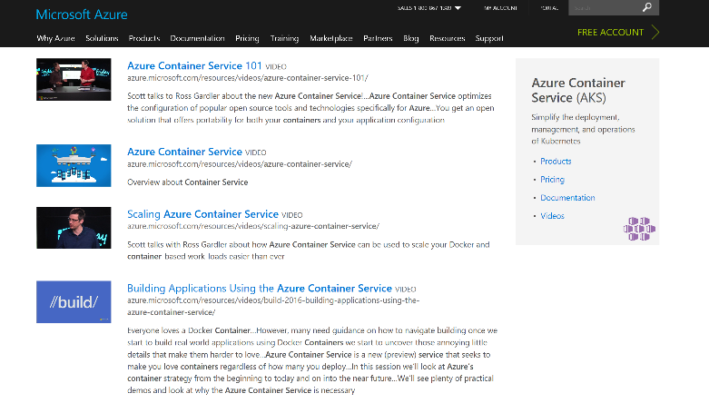
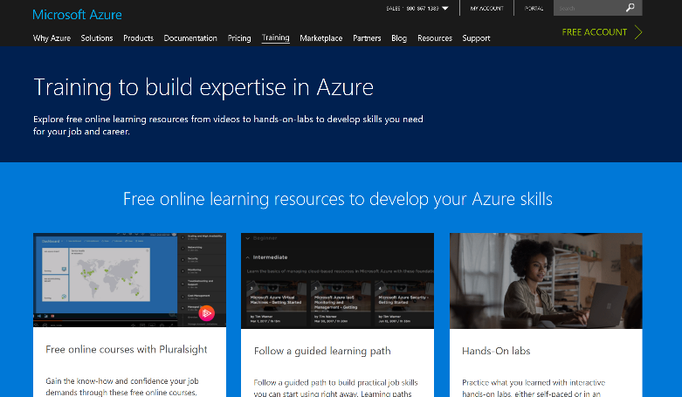
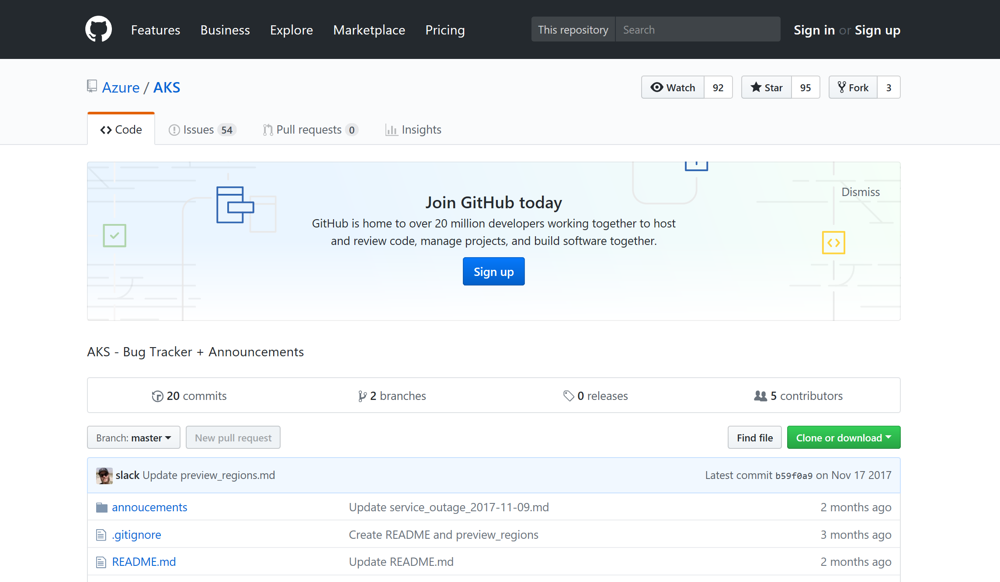
Azure container resources
Azure Kubernetes Service (AKS)
Azure Container Instances (ACI)
Azure Container Registry
OSBA announcement blog
Draft webpage
Helm webpage
Brigade webpage
Kashti announcement blog
Sign up for a free Azure account
Check out the Azure container videos page
Hone your skills with Azure training
Get the code from GitHub

Slide 83
Appendix Sections

Slide 84
So many choices…
Service | Sweet spot
Azure Web Apps | Deploy scalable web apps and services using containers
Service Fabric | Build microservice applications packaged in containers
Azure Kubernetes Service | Use OSS orchestrators to manage containers across VMs
Azure Batch | Schedule large scale batch processes deployed in containers
Azure Container Instances | Run individual containers with no VM management

Slide 85
Why Change?
Aging infrastructure
Lack of agility
High Cost
Aging hardware, operating systems, and business applications in the datacenter can impact:
Operational costs, efficiency, and reliability
Capital expenditure requirements
Security, audit, and regulatory compliance
Deployment time of new services
Operation is time (and budget) consuming
Innovation is happening outside IT inside business areas
Longer release cycles, monolithic and highly coupled architecture
Highly IT dependent
Low application performance and time-to-market compromise business agility

Slide 86
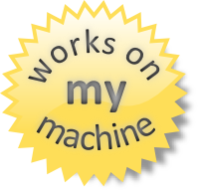
Why containers?
Repeatable execution
immutable environment
reusable and portable code (“Build, Ship, and Run”)
Consistency across development, test, & production
Fast & agile app deployment; instant startup
Cloud portability
Density, partitioning, scale
Diverse developer framework support
Promotes microservices

Slide 87
Docker, Docker, Docker
Containers have been around for many years
Linux kernel: cgroups, namespaces
Docker Inc. did not invent them
They created open source software to build and manage containers
Docker makes containers easy
Super easy. Fast learning curve
Docker is a container format and a set of tools
Docker CLI, Docker Engine, Docker Swarm, Docker Compose, Docker Machine
Notes:
Can skip the container slides based on audience level

Slide 88
What is a container?
Slice up the OS to run multiple apps on a single VM
Every container has an isolated view and gets
it’s own file system
it’s own PID0 and eth0 network interface
Container and apps share lifecycle
Shared kernel, very fast start-up, and repeatable execution
Cannot mix OS
VM/Host
Container: App-A:v1
Container: App-B:v3
Container: App-A:v2
App-A v1
App-B v3
App-A v2
Lib-L v2
Lib-L v3
Lib-L v3
Lib-M v2
Runtime v5
Runtime v7
Runtime v6

Slide 89

/lib
/src
/lib2
/config

Slide 90

Package Container
ratings-web:v1
ENV
CMD
Ports
Notes:
Slice up the OS to run multiple apps on a single VM
Every container has an isolated view and gets
it’s own file system
it’s own PID0 and eth0 network interface
Container and apps share lifecycle
Shared kernel, very fast start-up, and repeatable execution
Cannot mix OS

Slide 91
Push Container Image
App-A
Image
Repository
docker push image:tag
ENV
CMD
Ports
Notes:
Slice up the OS to run multiple apps on a single VM
Every container has an isolated view and gets
it’s own file system
it’s own PID0 and eth0 network interface
Container and apps share lifecycle
Shared kernel, very fast start-up, and repeatable execution
Cannot mix OS

Slide 92


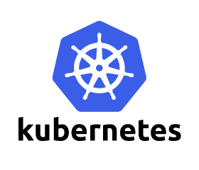


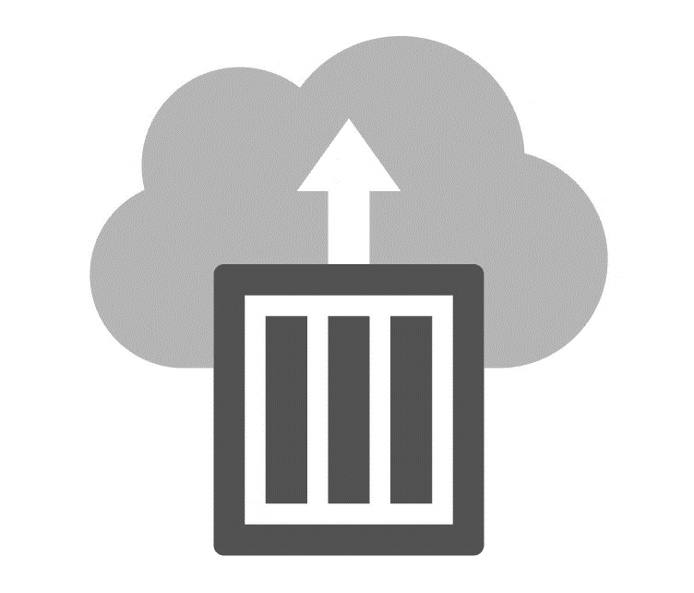
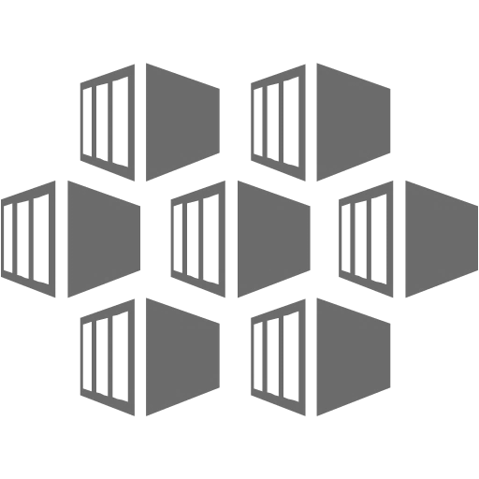
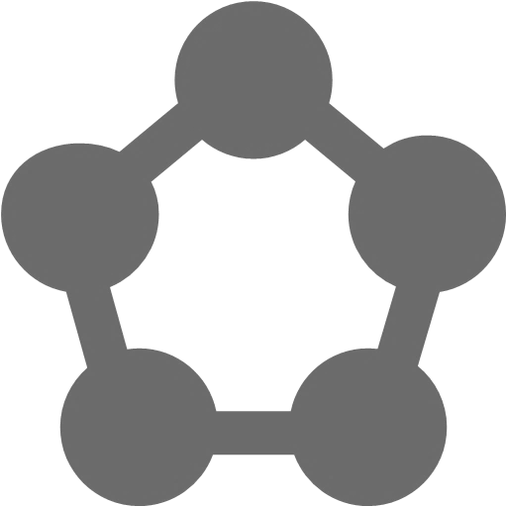


Azure Container Support
Pivotal
Cloud Foundry
Mesos DC/OS
Azure Container Instance
Azure Kubernetes Service (AKS)
Service Fabric
Web Apps
Batch
Notes:
Can you this slide or slide 25 here

Slide 93




For customers with a preferred container platform Pivotal Cloud Foundry  Kubernetes  Docker Enterprise Edition Red Hat OpenShift  Mesosphere DC/OS
Azure Kubernetes Service (AKS)
Azure Container Instances (ACI)
Azure Container Registry
Open Service Broker API (OSBA)
Release Automation Tools
Help them bring that platform to Azure

Slide 94
For customers without a preferred container platform…
Azure Kubernetes Service (AKS)
Azure Container Instances (ACI)
Azure Container Registry
Open Service Broker API (OSBA)
Lead with profiling questions, then make recommendations based on the customer profiles
Release Automation Tools
For more details, refer to the container cheat sheet

Slide 95
Microservices

Slide 96
microservices ≠ containers
microservices is an architectural design approach
containers are an implementation detail that often helps

Slide 97
Microservices Benefits
Independent deployments
Enables continuous delivery
No downtime upgrades
Improved scale and resource utilization per service
Fault isolation
Security isolation
Services can be distributed across multiple servers or environments
Multiple languages / diversity
Smaller, focused teams
Code can be organized around business capabilities
Autonomous developer teams

Slide 98
Microservices – The Hard Part
Deployment is complex
Testing is difficult
Debugging is difficult
Monitoring/Logging is difficult
New service versions must support old/new API contracts
Distributed databases make transactions hard
Cluster and orchestration tools overhead
Distributed services adds more network communication
Increased network hops
Requires failure/recovery code
Need service discovery solution
Advanced DevOps capability: short-term pain for long-term gain

Slide 99
12-Factor Apps
http://12factor.net
Notes:
Explain the benefits of 12 factor apps without walking through all of them.
Recommended guidelines for good microservices apps

Slide 100
12-Factor Apps (1-5)
Single root repo; don’t share code with another app
Deploy dependent libs with app
No config in code; read from environment vars
Handle unresponsive app dependencies robustly
Strictly separate build, release, & run steps
Build: Builds a version of the code repo & gathers dependencies
Release: Combines build with config ReleaseId (immutable)
Run: Runs app in execution environment
Notes:
Single root repo; don’t share code with another app
Deploy dependent libs with app
No config in code; read from environment vars
Handle unresponsive app dependencies robustly
Strictly separate build, release, & run steps
Build: Builds a version of the code repo & gathers dependencies
Release: Combines build with config → ReleaseId (immutable)
Run: Runs app in execution environment

Slide 101
12-Factor Apps (6-12)
App executes as 1+ stateless process & shares nothing
App listens on ports; avoid using (web) host
Use processes for isolation; multiple for concurrency
Processes can crash/be killed quickly & start fast
Keep dev, staging, & prod environments similar
Log to stdout (dev=console; prod=file & archived)
Deploy & run admin tasks (scripts) as processes
Notes:
App executes as 1+ stateless process & shares nothing
App listens on ports; avoid using (web) host
Use processes for isolation; multiple for concurrency
Processes can crash/be killed quickly & start fast
Keep dev, staging, & prod environments similar
Log to stdout (dev=console; prod=file & archived)
Deploy & run admin tasks (scripts) as processes

Slide 102
ConfigMaps and Secrets
Flexible configuration model for Kubernetes
Both Secrets and ConfigMaps can be used as ENV vars or files
Secrets
Use Secrets for things which are actually secret like API keys, credentials, etc
Secret values are base64 encoded and automatically decoded for pods
ConfigMaps
ConfigMaps for configuration that doesn’t have sensitive information. However, there are pros/cons with each
ConfigMaps designed to more conveniently support working with strings
Notes:
Decouple configuration artifacts from image content to keep containerized applications portable

Slide 103
Namespaces
Allow for multiple virtual clusters backed by the same physical cluster
Logical separation
Namespace used in FQDN of Kubernetes services
Eg - <service-name>.<namespace-name>.svc.cluster.local
Every Kubernetes resource type is scoped to a namespace (except for nodes, persistentVolumes, etc.)
Intended for environments with many users, teams, projects
Notes:
Can use –all-namespaces option with kubctl if resources can’t be found
Compatible with RBAC; can lock down namespaces
Useful for clusters that have multiple teams deploying to

Slide 104

Role Based Access Control
Allows for dynamic policies against k8s API for authZ
In version 1.6, this is a beta feature
Can create both ”Roles” and “ClusterRoles”
Can configure api-server and kubectl to use Azure AD for access
To grant permissions:
Use ”RoleBindings” for within namespaces
Use “ClusterRoleBindings” for cluster-wide access
Can contain users, groups, service accounts
Control access to specific resources or API verbs

Slide 105

Networking in the Container World

Slide 106



Multi-Host Networking
Agent1
Agent2
eth0 : 10.0.0.6
eth0 : 10.0.0.8
docker0 : 172.17.0.1
docker0 : 172.17.0.1
eth0 : 172.17.0.3
eth0 : 172.17.0.3
eth0 : 172.17.0.4
eth0 : 172.17.0.4
vethxxx
vethxxx
vethxxx
vethxxx

Slide 107




Multi-Host Networking
Agent1
key/value
store
Agent2
eth0 : 10.0.0.6
eth0 : 10.0.0.8
docker0 : 172.17.0.1
docker0 : 172.17.0.1
192.168.0.0/24
eth0 : 192.168.0.1
eth0 : 192.168.0.3
eth0 : 192.168.0.2
eth0 : 192.168.0.4
vethxxx
vethxxx
vethxxx
vethxxx

Slide 108
What is service discovery?
Problem: How service can find and communicate with another one running into the same cluster?
Service Registry/Naming Service
Service Announcement
Lookup/Discovery
Load Balancing
?!?

Slide 109

Networking in Kubernetes
Kubernetes Networking model introduces 3 methods of communications:
Pod-to-Pod communication directly by IP address. Kubernetes has a Pod-IP wide metric simplifying communication.
Pod-to-Service Communication – Client traffic is directed to service virtual IP by iptables rules that are modified by the kub-proxy process (running on all hosts) and directed to the correct Pod.
External-to-Internal Communication – external access is captured by an external load balancer which targets nodes in a cluster. The Pod-to-Service flow stays the same.
Notes:
When the backend Service is created, the Kubernetes master assigns a virtual IP address, for example 10.0.0.1. Assuming the Service port is 1234, the Service is observed by all of the kube-proxy instances in the cluster. When a proxy sees a new Service, it installs a series of iptables rules which redirect from the VIP to per-Service rules. The per-Service rules link to per-Endpoint rules which redirect (Destination NAT) to the backends.
When a client connects to the VIP the iptables rule kicks in. A backend is chosen (either based on session affinity or randomly) and packets are redirected to the backend. Unlike the userspace proxy, packets are never copied to userspace, the kube-proxy does not have to be running for the VIP to work, and the client IP is not altered.
This same basic flow executes when traffic comes in through a node-port or through a load-balancer, though in those cases the client IP does get altered.

Slide 110

Service Discovery with Kubernetes
Nodes, Deployments, Pods, Services
Services
Expose the services
Works with platform Load Balancers to get public IPs
Internal load balancing between pods
kube-dns (preferred)
Name service enabled in Kubernetes (Default in ACS)
Environment Variables
Every Service is assigned environment variables with information of the service
REDIS_MASTER_SERVICE_HOST=10.0.0.11 REDIS_MASTER_SERVICE_PORT=6379 REDIS_MASTER_PORT=tcp://10.0.0.11:6379 REDIS_MASTER_PORT_6379_TCP=tcp://10.0.0.11:6379 REDIS_MASTER_PORT_6379_TCP_PROTO=tcp REDIS_MASTER_PORT_6379_TCP_PORT=6379 REDIS_MASTER_PORT_6379_TCP_ADDR=10.0.0.11
Source: https://kubernetes.io/docs/tutorials/kubernetes-basics/expose-intro/
Notes:
NOTE ON ENVIRONMENT VARIABLES: This does imply an ordering requirement - any Service that a Pod wants to access must be created before the Pod itself, or else the environment variables will not be populated. DNS does not have this restriction.

Slide 111
Ingresses
Typically, services and pods have IPs only routable by the cluster network
All traffic that ends up at an edge router is either dropped or forwarded elsewhere
Ingress is a collection of rules that allow inbound connections to reach the cluster services
An Ingress controller is responsible for fulfilling the Ingress, usually with a loadbalancer, though it may also configure your edge router or additional frontends to help handle the traffic in an HA manner
Notes:
I
Pods won’t survive scheduling failures, node failures, or other evictions, such as due to lack of resources, or in the case of node maintenance.

Slide 112
Container Network Interface (CNI)
CNI (a CNCF project) is a spec for plugins to configure Linux container network interfaces
Wide range of support
Kubernetes, OpenShift, Cloud Foundry, Mesos, rkt, etc.
Examples
Calico, Weave, Contiv, etc.
Azure CNI plug-in integrates Azure VNET into kubernetes clusters
Use acs-engine
Notes:
CNCF = Cloud Native Computing Foundation
https://github.com/Azure/azure-container-networking/blob/master/docs/acs.md

Slide 113
Daemonsets
Ensures that all (or some) nodes run a copy of a pod
Doesn't care if a node is marked as unschedulable
Can make pods even if the scheduler is not running

Slide 114
StatefulSets
Used for workloads that require consistent, persistent hostnames e.g. etcd-01, etcd-02
One PersistentVolume storage per pod
StatefulSet example - zookeeper
StatefulSet example - cockroachdb
Notes:
Manages the deployment and scaling of a set of Pods, and provides guarantees about the ordering and uniqueness of these Pods.
StatefulSets are valuable for applications that require one or more of the following.
Stable, unique network identifiers.
Stable, persistent storage.
Ordered, graceful deployment and scaling.
Ordered, graceful deletion and termination.
Ordered, automated rolling updates.

Slide 115
Jobs
Creates one or more pods and ensures that a specified number of them successfully terminate
3 types of jobs
Non-parallel Jobs - e.g. single pod done when exit is successful
Parallel Jobs with a fixed completion count - e.g. one successful pod for each value in the range 1 to .spec.completions
Parallel Jobs with a work queue that coordinate with each other and terminate when one pod exits successfully

